Slide 1
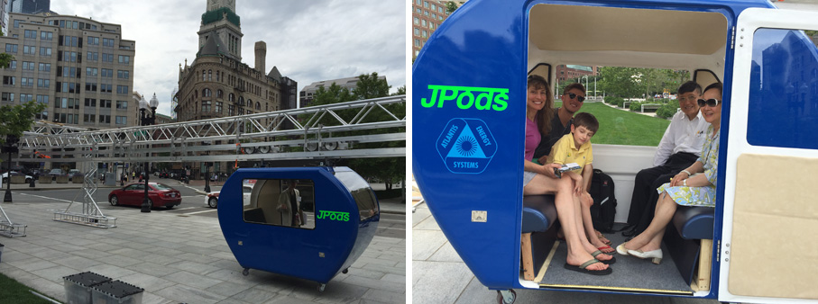
The Physics of JPods
Part 1 - Determining the Power

Slide 2
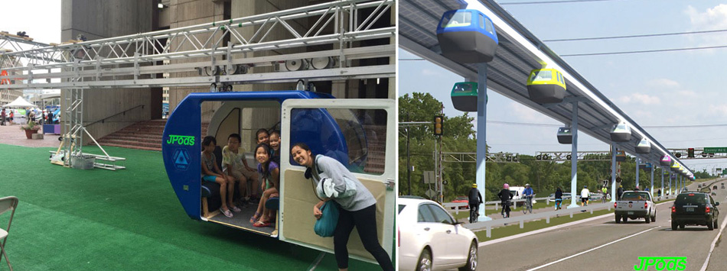
Definitions are needed.
JPods vehicle - A personal rapid transit (PRT) vehicle, suspended from an overhead railway, that works within a collaborative network to transport people and cargo directly from one place to another.
JPods Concepts

Slide 3
Here is the answer to everyone’s first question.
Why are they called JPods?
In 2000 Bill James was sketching up his first conceptual ideas of how a small vehicle could be suspended from an overhead rail. He thought it looked like a “J”. So, he called it a “JPods”.

Slide 4
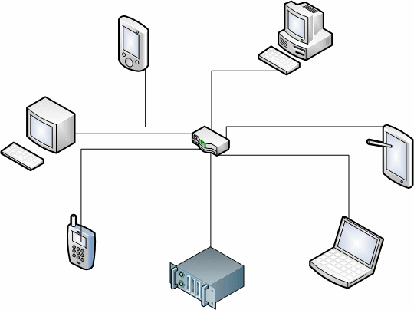

What is Special About JPods?
NOT THIS!
Bill James’ patent #6,810,817 was issued in 2004 and defines how independently computer controlled vehicles can talk to each other, make decisions together and behave intelligently to move JPods in a distributed collaborative network.
There is no central computer that controls the vehicles. Each is controlled independently by its own computer.
Each JPods vehicle does not need to talk with every other device in the network, only the ones closest to it. JPods use relatively weak radio signals to communicate. The effective radio range is less than 100 meters. Like “blind termites” each vehicle senses its surroundings, and Hive Technologies™ integrates many perspectives into a mosaic.
MORE LIKE THIS!

Slide 5
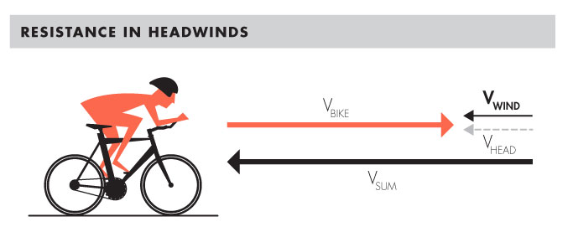
How Much Energy Does a JPods Use?
The largest energy use is overcoming wind resistance.
The “Drag Force” , D, is
D = C_{d} ρ V² A
2 where: C_{d} = drag coefficient
ρ = air density
V = air speed
A = frontal area

Slide 6
How to Determine Drag Force is Based Upon Guesstimates
Until the JPods is built and put into a wind tunnel, any number for the drag coefficient, C_{d} , will be wrong.
Until the JPods is designed and measured, the effective frontal area, A, will be wrong.
Start with some assumptions:
1. JPods shape C_{d} is 0.3, typical of a small automobile.
[ref: Wikipedia, note: Toyota Prius is 0.29]
JPods effective frontal area is assumed to be 0.9 m²
[ref: Wikipedia, note: Toyota Camry is 0.7 m²]

Slide 7

Calculate the Drag Force at 30 mph With 25 mph Headwind
V = 25 mph + 30 mph = 55 mph
= 24.59 meters per second
ρ = 1.2922 kg/m³ density of air at sea level
D = C_{d} ρ V² A
2
= 0.3 * 1.2922 kg/m³ * (24.59 m/sec)² * 0.9 m²
2
= 105.5 kg-m/sec²
= 105.5 N

Slide 8

Calculate the Power Needed to Overcome the Drag Force
Work is Force applied over a Distance
W = Force * Distance
Pick a convenient distance, say 1 meter.
W_{air} = Drag * distance
= 105.5 N * 1 m
= 105.5 N-m
= 105.5 J
The time needed to travel 1 meter relative to the air is
t = Distance / Speed
= 1 m
24.59 m / sec
second
= 0.0407 sec
Power is the rate of work being done.
Power = Work / Time
P_{air} = W_{air} / time
= 105.5 J / 0.0407 sec
= 2592 W
= 2.592 kW

Slide 9
Calculate the Power Needed to Overcome the Drag Force in Still Air
D = C_{d} ρ V² A
2
= 0.3 * 1.2922 kg/m³ * (13.41 m/sec)² * 0.9 m²
2
= 31.37 kg-m/sec²
= 31.37 N
The time needed to travel 1 meter is
t = Distance / Speed
= 1 m / 13.41 meters per second
= 0.0746 sec
W_{air} = Drag * distance
= 31.37 N * 1 m
= 31.37 N-m
= 31.37 J
The power used is
P_{air} = W_{air} / time
= 31.37 J / 0.0746 sec
= 420.5 W
= 0.421 kW

Slide 10

What Other Power is Needed by a JPods?
Power is needed for:
Acceleration
Going up Grades
Internal & External Lighting
Ventilation, Heating & Cooling of Passenger Compartment
Computer and its Touchscreen
Communications Radio System
CCTV
****
And finally, an excess must be added for friction and other inefficiencies losses.

Slide 11

Calculate the Power Needed for Acceleration
Final speed is 30 mph, or
V = 13.41 meters per second
The general equation for speed, V, during acceleration, a, at a time, t, is
V = at + V₀
where V₀ = initial speed
V₀ = 0, i.e. JPods is stopped
Either a or t can be found if the other is specified.
t = V/a
Assume a relatively moderate acceleration, 0.2 gravities (g)
g = 9.81 m/sec²
so → a = 1.962 m/sec²
t = 13.41 m/sec
1.962 m/sec²
= 6.84 seconds

Slide 12
Calculate the Power Needed for Acceleration (continued)
The maximum weight JPods plus cargo (or people) and bogie will be limited to 1700 lbm, or 771.8 kg.
The force needed for the acceleration, a, is
F_{acc} = ma
= 771.8 kg * 3.92 m/sec
= 3025.5 N
The work done to cause the acceleration is the final kinetic energy of the JPods.
W_{acc} = ½ m V²
= ½ * 771.8 kg * (13.41 m/sec)²
= 69396 J
The power used is
P_{acc} = W_{acc} / time
= 69396 J / 6.84 sec
= 10146 W
= 10.15 kW

Slide 13
Calculate the Power Needed Travel Up a Grade
The greatest grade allowed in a JPods system is 6%.
A JPods will be traveling at a steady speed.
The work going uphill is -
W_{up} = m g h
where h = vertical distance traveled
A JPods traveling at V = 13.41 m/sec (30 mph) along a rising rail for 100 meters will increase in vertical elevation. The time to move this distance is
t_{up} = 100 m
13.41 m/sec
= 7.457 seconds
100 m
The angle of a 6% incline is
α = arctan (0.06)
= 0.059928 radians
= 3.433 degrees
h =
0.06 Z m
α
Z m
The vertical distance is
h = 100 m sin(α)
= 5.98 m

Slide 14
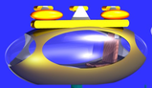
Calculate the Power Needed Travel Up a Grade (continued)
The work going uphill is -
W_{up} = m g h
= 771.8 kg * 9.81 msec² * 5.98 m
= 45277 J
The power used is
P_{up} = W_{up} / time
= 45277 J / 7.457 sec
= 1493 W
= 1.49 kW
100 m
h =
5.98 m
It is seen that the power needed to accelerate to the JPods to speed is greater than the power needed. To climb a grade.
α

Slide 15
Estimate Power Needs for Other Uses
Power User | Power
Internal Lighting | 20 W (LEDs)
External Lighting | 30 W (LEDs)
Ventilation, Heating & Cooling of Passenger Compartment | 550 W*
Computer and its Touchscreen | 50 W
Communications Radio System | 100 W
Misc. Sensors | 75 W
CCTV | 200 W
* Typical of small room air conditioner, 4.8A at 115 V ≈ 550 W

Slide 16
Summarize all Power Needs
Maximum (30 mph, 25 mph headwind, accelerating)
Power User | Power
JPods at 30 mph with 25 mph headwind | 2592 W
JPods accelerating to 30 mph | 10146 W
Internal Lighting | 20 W (LEDs)
External Lighting | 30 W (LEDs)
Ventilation, Heating & Cooling of Passenger Compartment | 550 W
Computer and its Touchscreen | 50 W
Communications Radio System | 100 W
Misc. Sensors | 75 W
CCTV | 200 W
TOTAL | 13763 W

Slide 17
Summarize all Power Needs
Normal (30 mph in still air)
Power User | Power
JPods at 30 mph in still air | 421 W
Internal Lighting | 20 W (LEDs)
External Lighting | 30 W (LEDs)
Ventilation, Heating & Cooling of Passenger Compartment | 550 W
Computer and its Touchscreen | 50 W
Communications Radio System | 100 W
Misc. Sensors | 75 W
CCTV | 200 W
TOTAL | 1446 W

Slide 18
Summarize all Power Needs
Minimum (stopped at station)
Power User | Power
Internal Lighting | 20 W (LEDs)
External Lighting | 30 W (LEDs)
Ventilation, Heating & Cooling of Passenger Compartment | 550 W
Computer and its Touchscreen | 50 W
Communications Radio System | 100 W
Misc. Sensors | 75 W
CCTV | 200 W
TOTAL | 1025 W

Slide 19
The Physics of JPods
Part 2 - Adding Up the Energy

Slide 20
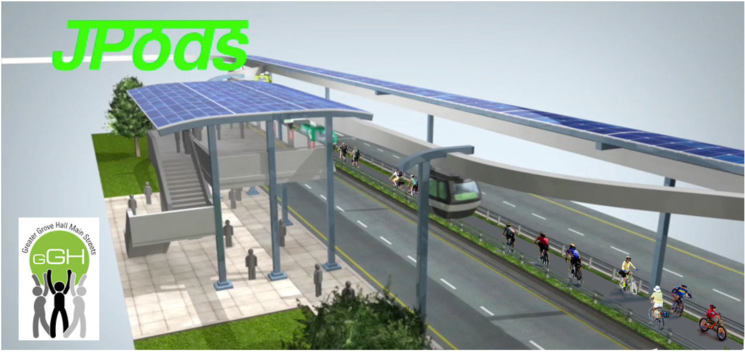
Determine Energy Use of a JPods Vehicle
A JPods will accelerate out of a station until it is moving 30 mph. It will travel at a constant speed until it decelerates to stop at is destination station.
The energy use will be broken down into distinct time periods.
Waiting
Accelerating
Steady Speed
Decelerating

Slide 21

JPods Energy Use While Waiting
The rate of using energy was calculated in Part 1. The amount of energy used depends upon how long the JPods waits from the time it stops to unload a passenger until it is reloaded and begins to move.
The minimum rate of energy use was found to be 1025 W (1.025 kW).
A waiting JPods will consume 1.03 kW-hr for each hour it sits idle. At $0.10 per kW-hr., this costs 10 cents.

Slide 22
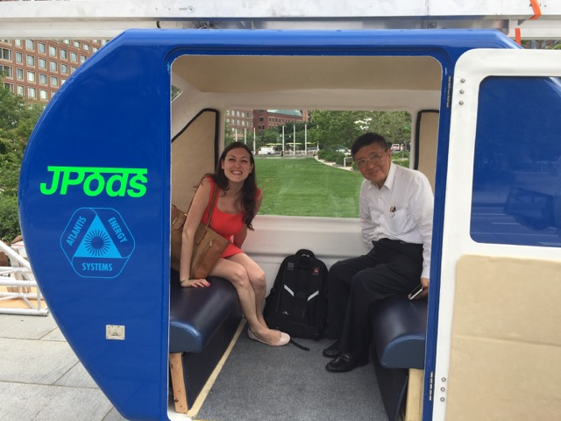
JPods Acceleration Energy Use
During acceleration, energy is used both to do the acceleration and also to overcome the air drag force.
D = C_{d} ρ V² A
2
Where the speed, V, depends upon the time, t.
V = at
The force needed for the acceleration, a, is
F_{acc} = ma
The combined Drag and Accelerations Forces are
F_{combined} = C_{d} ρ (at)² A + ma
2

Slide 23
JPods Acceleration Energy Use (continued)
The work done at any time when traveling an incremental distance Δd
ΔW = F_{combined} Δd = C_{d} ρ (at)² A Δd + ma Δd
2
At any time the incremental distance traveled during a small time step is
Δd = V Δt
= at Δt
The incremental work is
ΔW = C_{d} ρ (at)³ A Δt + ma²t Δt
2
The total work performed is
∫dW = C_{d} ρ a³A ∫t³ dt + ma² ∫t dt
2
W = C_{d} ρ a³A t⁴ + ma² t²
8 2
In Part 1 the time for the acceleration to 30 mph was calculated to be 6.84 seconds.

Slide 24
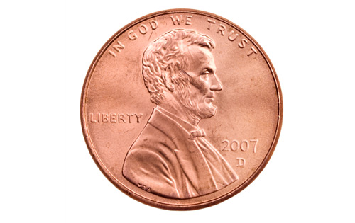
JPods Acceleration Energy Use (continued)
Putting values into the formula
W = C_{d} ρ a³A t⁴ + ma² t²
8 2
= 0.3 * 1.2922 kg/m³ * (1.962 m/sec²)³ * 0.9 m² * (6.84 sec)⁴
+ 771.8 kg * (1.962 m/sec²)² * (6.84 sec)²
= 144768 J
= 0.0402 kW-hr.
At $0.10 per kW-hr., this costs 0.4 cents to accelerate the JPods to 30 mph.

Slide 25
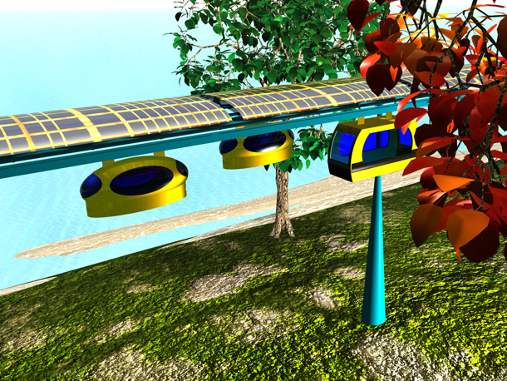
JPods Steady Speed Energy Use
In Part 1 the continuous energy use of a JPods at 30 mph in still air was found to be 1446 W (1.446 kW).
One hour of steady speed operation uses
1.466 kW-hr of energy.
At $0.10 per kW-hr., this costs 10.5 cents.

Slide 26
JPods Deceleration Energy Use
When decelerating, the JPods will not use any more energy than when idle. If the bogie wheel motor have regenerative capability, the motors can behave as generators and put electricity back into the JPods batteries.
An idle JPods will consume 1.03 kW-hr for each hour it sits idle. The deceleration time is about the same as the acceleration time, 6.84 seconds.
At $0.10 per kW-hr., this costs
1.03 kW * 6.84 sec * 1 hour * $0.10 = $0.0002
3600 sec kW-hr
--- or ---
0.02 cents

Slide 27

Putting the Energy and Its Costs Together
A JPods waits for about 3 minutes until the next passenger climbs aboard. The typical JPods trip takes about 15 minutes. A 15 minute trip is 7.5 miles.
$?
The total energy use is
Waiting 3 min * 1.03 kW-hr = 0.052 kW-hr
60 min/hr. Hour
Accelerating 0.0402 kW-hr.
Steady Speed
15 min * 1.47 kW-hr = 0.368 kW-hr
60 min/hr. Hour
Decelerating 0.002 kW-hr.
TOTAL ENERGY 0.462 kW-hr
At $0.10 per kW-hr., this trip costs 4.6 cents.
--- or --- 0.061 cents/per mile

Slide 28
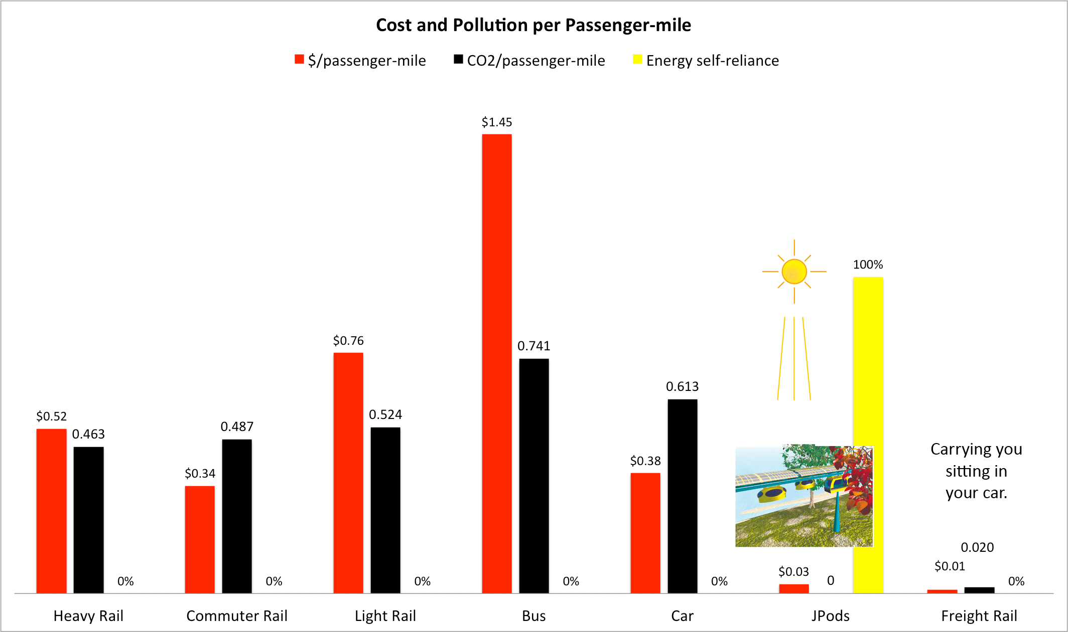
Compare JPods to Other Transportation Methods
Source: Department of Energy’s Transportation Energy Data Book
Transporting a passenger one mile
by car requires 3447 BTUs = 1.01 kW-hr
by bus requires 4118 BTUs = 1.21 kW-hr
by rail requires 2520 BTUs = 0.75 kW-hr.
by JPods requires = 0.062 kW-hr

Slide 29
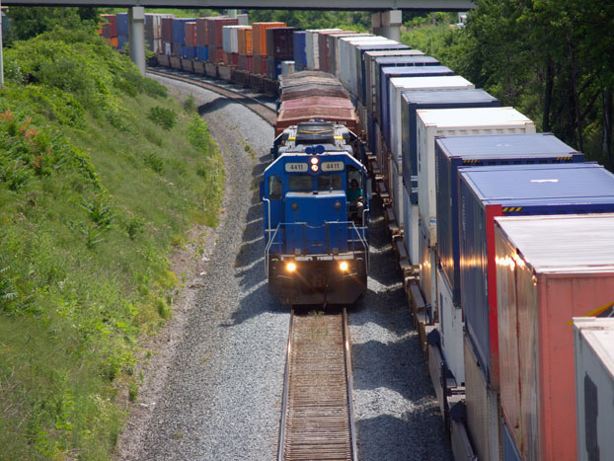
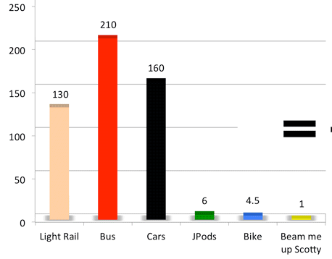


Parasitic Energy Ratio
Freight rail average 476 ton-miles per gallon because they do not repetitively start-stop.
Eliminate Start-Stops
Eliminate Parasitic Mass
Parasitic Energy Ratio
Moving Mass
4,000 + 120
Start-Stop
applications
of power
x
Payload Mass
120 pounds
www.JPods.com
Notes:
We can change the lifeblood of our economy from oil to ingenuity.
There is between a 10x and 28x productivity gain.
We can live within a solar budget.

Slide 30
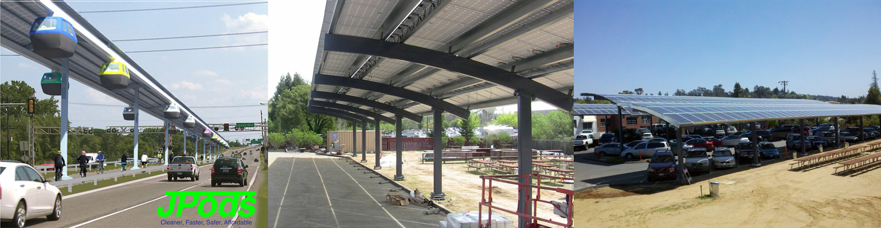
Energy Collection
By using the distributed nature of the transportation networks to collect the power to drive the network, JPods gather 40,000 vehicle-miles of power per mile of rail per typical day.
Thomas Edison, 1910:
"Sunshine is spread out thin and so is electricity. Perhaps they are the same, Sunshine is a form of energy, and the winds and the tides are manifestations of energy.”
“Do we use them? Oh, no! We burn up wood and coal, as renters burn up the front fence for fuel. We live like squatters, not as if we owned the property.
“There must surely come a time when heat and power will be stored in unlimited quantities in every community, all gathered by natural forces. Electricity ought to be as cheap as oxygen...."

Slide 31
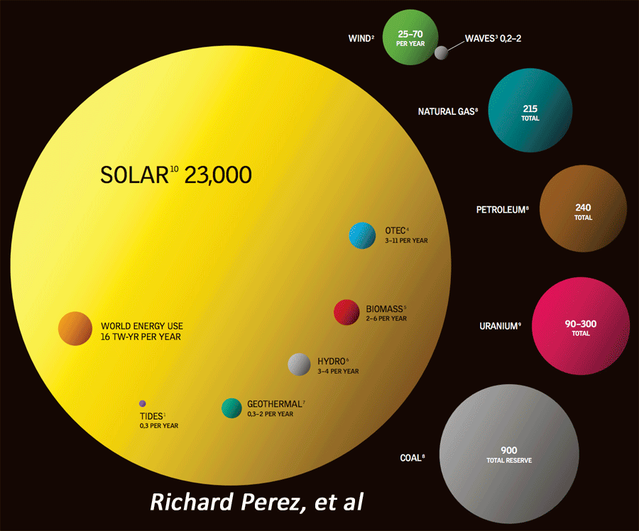
“But the sun is intermittent”
False! Really false.
True: The sun is a nuclear reactor that burns 24 hour a day, seven days of the week.
We need only be a clever as a tree to live within a solar budget.

Slide 32
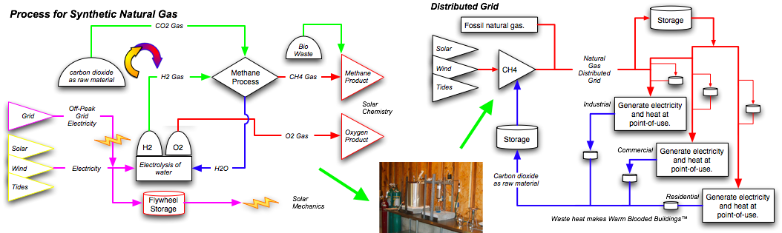
“But you cannot store sunshine”
False! Really false.
True: Food, wood, coal, oil, natural gas, and even nuclear fuels are stored solar energy.
We need only be a clever as a tree to live within a solar budget.
Methane and similar hydrocarbons will be used to store energy in a closed loop, pollution free system.

Slide 33
The Physics of JPods
Part 3 - Supply & Storing the Energy

Slide 34
Summary:
How a JPods Uses the Energy
The JPods runs on 48-96 VDC.
Both bogies must each have 5-15 HP motors.
JPods can operate at least ½ hour between recharges and/or batter swaps.
Many new battery, graphene, and storage innovations are expected to cause a constant shift in storage devices.
Inductive power transfer is the preferred method recharging JPods energy storage devices.
The following slides show how the JPods energy components are sized.

Slide 35
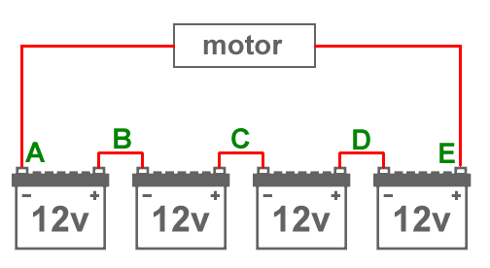
Determine the Way Energy is Provided to a JPods Vehicle
There are several methods to provide energy to the onboard electronics, air conditioning, lighting, and bogie drive wheel motors.
The method selected is a tradeoff of first cost, maintenance costs, lifetime, reliability, convenience and safety.
Safety is always first. We like 48 volts* for intrinsic safety but will likely need the power delivery of 96 voles. Both are radically safer than a tank of gas.
- +
* It is the amperage that kills. The human body normally has enough electrical resistance to limit the current to a safe amount at 48 VDC, but some people have died with lower voltages. Stay dry!
- 48 VDC +

Slide 36
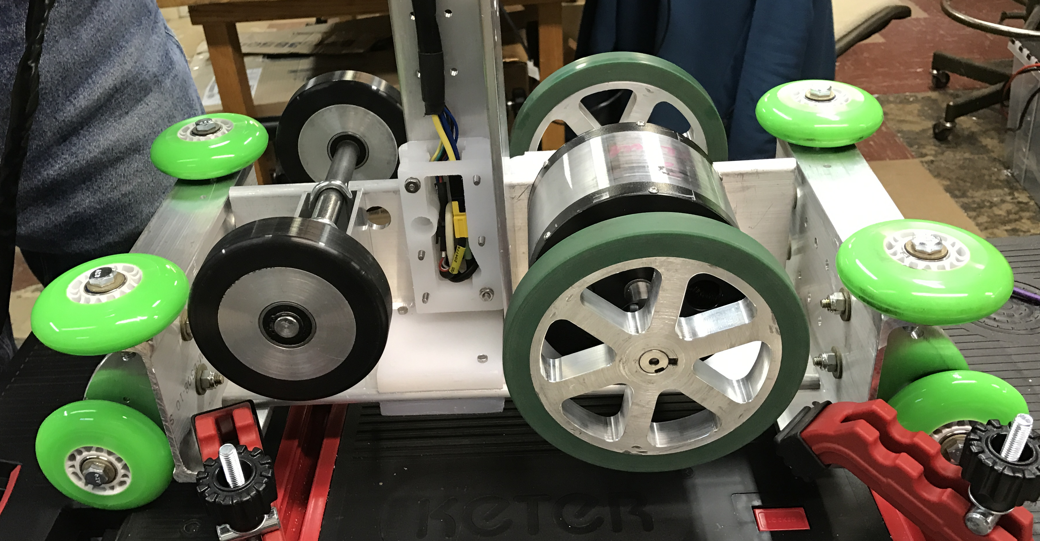
JPods Power Use In Motion
The maximum power needed at the JPods drive wheels is 12.74 kW.
= 17.01 HP (includes 25 MPH headwind)
This is the power needed just as acceleration to 30 mph is completed.
At that point the power need drops to 2.59 kW
= 3.47 HP (includes 25 MPH headwind)
The JPods bogie drive wheels share the load. The next higher standard motor size above 8.5 HP is 10 HP.
Each bogie motor must be able to provide 5 to 15 HP. There can be 1 or 2 motors per bogie.

Slide 37

Transportation Needs Provided by JPods
JPods are expected to supplant existing modes to commuter transportation. The current major modes of commuter transportation are summarized below.
Source: U.S. Department of Transportation Federal Highway Administration
Average commute to work
by car = 12.6 miles average 22.8 minutes
by bus = 9.4 miles average 48.9 minutes
by commuter rail = 12.2 miles average 12.2 minutes
The statistics above include people commuting from suburban areas. The JPods should have sufficient energy onboard to travel about 12.6 miles with some margin.

Slide 38
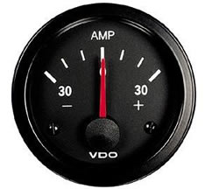
JPods Must Operate for ½ Hour Using Available Energy
A typical JPods trip will last less than 25 minutes (12.5 miles or 20.1 km). The energy needed for the JPods vehicle to travel for ½ hour is as follows:
The energy needed for 30 minutes at 2.59 kW (3.47 HP ) is 1.30 kW-hr.
To provide 2.59 kW, at 48 VDC the JPods vehicle is using
2590 W = 54 Amperes
48 V

Slide 39
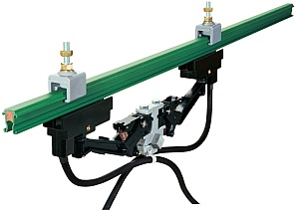
JPods Must Have Energy
There are optional ways to supply power to JPods.
One method commonly used by commuter rail is the use of brushes with a power rail. This option is unattractive for two reasons: high first cost and high maintenance cost. The advantage is that JPods can operate continuously as long as power is supplied to the power rail.
Power Rail with Brush Arm
Another option is similar. This method is use of an inductive power pickup to draw energy from a power rail. It has the disadvantage of being significantly more expensive than the brushed power rail system. The advantage is that JPods can operate continuously as long as power is supplied to the power rail.

Slide 40
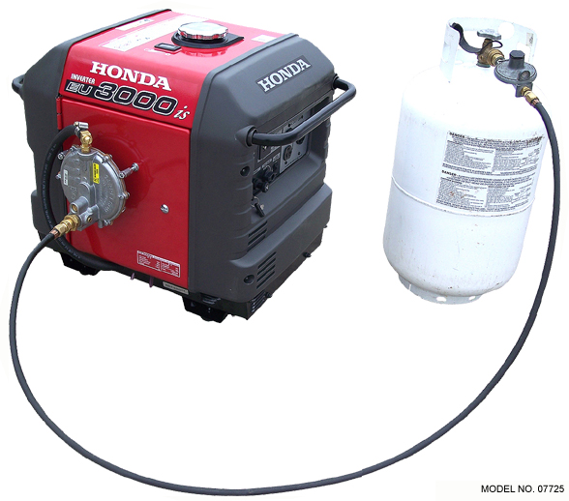
JPods Carrying Fuel is Not a Good Idea
An alternative to direct electricity supply is for each JPods to have a conventional gasoline, kerosene or propane fueled generator. This has several disadvantages primarily due to safety and emissions. Additionally, the JPods vehicle must carry the generator and fuel tank. The advantage is that JPods can operate continuously as long as the fuel tank is not empty.

Slide 41
Led-Acid Batteries are Not Good for JPods
The alternative selected is for each JPods to carry an electrical storage device; battery or capacitors. The disadvantage is that the energy storage adds weight to the vehicle and that JPods must be regularly recharged.
Fork trucks carry large, heavy, high capacity batteries. These batteries are designed to be quickly disconnected and swapped for a fresh battery. This is unattractive because fork truck batteries are lead-acid based and take a relatively long time to recharge; hours.
A new development, the Ryden dual carbon battery can recharge in minutes, especially if not completely discharged. The alternatives for fast recharge of the batteries is direct electrical connections and inductive power transfer.

Slide 42
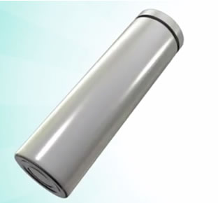
Picking a Storage Battery for JPods
Since batteries are using rated in Amp-Hours for 6 hour or 20 hour rates, a minimum battery capacity is needed to make a selection.
1300 W-hr = 27.08 A-hr
48 V
A 6 hour rated 48 V battery that can deliver 30 A-hr can supply
48 Volts * 30 Amp-Hours = 1440 W-hr. = 1.44 kW-hr
The Ryden dual carbon battery from Power Japan Plus charges 20 times faster than lithium ion batteries and can be fully discharged without damage to the battery. Additionally, these batteries stay cool and have no concern for overheating to cause fires.

Slide 43
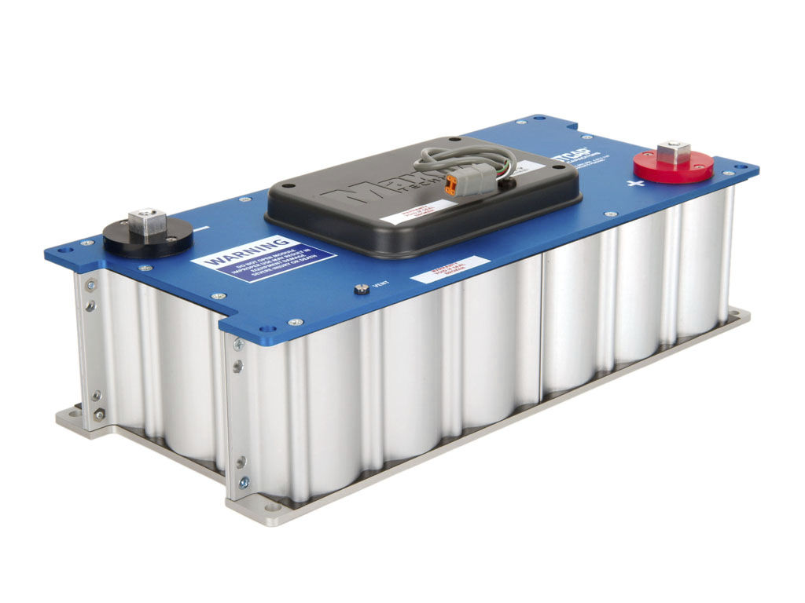
JPods Must Recharge Quickly Every ½ Hour
An alternative for each JPods to carry a battery electrical storage device is using power capacitors. The disadvantage is that the energy storage adds weight to the vehicle and that JPods must be regularly recharged.
Maxwell Technologies 48V ultracapacitor module; 52.8 W-hr capacity. 25 modules required.

Slide 44
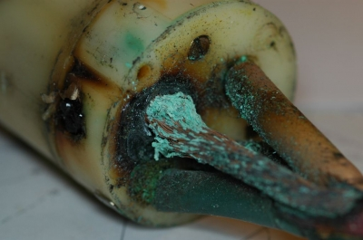
Selecting a Way to Recharge JPods
Direct electrical connection can be made with a JPods when it stops to load or unload passengers or cargo. A direct contact can be in the form of brushes that contact a power strip where JPods stop or it can be an electrical mechanically actuated to move into position to touch a matching electrical contact on the JPods.
As a general rule, the fewer moving parts, the better to minimize maintenance. Exposed electrical contacts are also subject to corrosion and wear.
Corrosion on exposed power contacts.

Slide 45
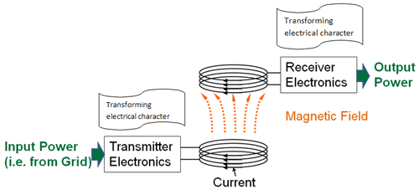
Inductively Recharging JPods
Inductive power transfer has been demonstrated in Korea to recharge buses when stopped to load and unload passengers.
A U.S. supplier of inductive transfer equipment is Qualcomm, Inc.

Slide 46
The Physics of JPods
Summary:
By suspending the vehicle from the rail, JPods removes most of the Parasitic Mass of the vehicle.
JPods grade separation and robotics removes the repetitive applications of power in Start-Stops.
Energy required to move people and cargo is cut by 10x.
Solar collectors over the rails powers the networks.
JPods networks store and transport excess energy.

