Slide 1
Final Decision Brief
The Decision Makers
Aaron Mallory
Andre Shinda
Samuel Edet
Jason Jin

Slide 2
Agenda
Team Members
BLUF
Research
System Analysis
Stakeholder Analysis
Explanation of Systematic Approach
Analysis and Final Recommendation

Slide 3
Team Member Roles and Responsibilities
Aaron Mallory- Group Leader
  Make sure the content of the project is correct and well formatted.
Andre Shinda- Schedule Manager
  Scheduling group meetings with team and stakeholders.
  Making Sure all deadlines are met.
Samuel Edet- Information System Specialist
  Operating Survey Monkey.
  Working In Excel.
Jason Jin-Stakeholder Manager
  Contacting all Major Stakeholders after the initial interviews.

Slide 4
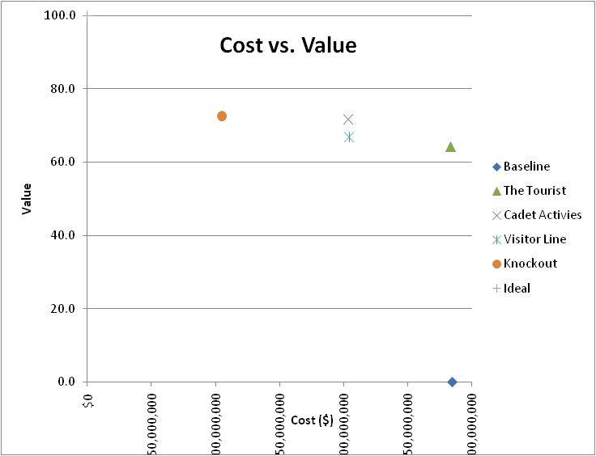
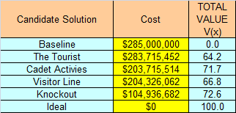
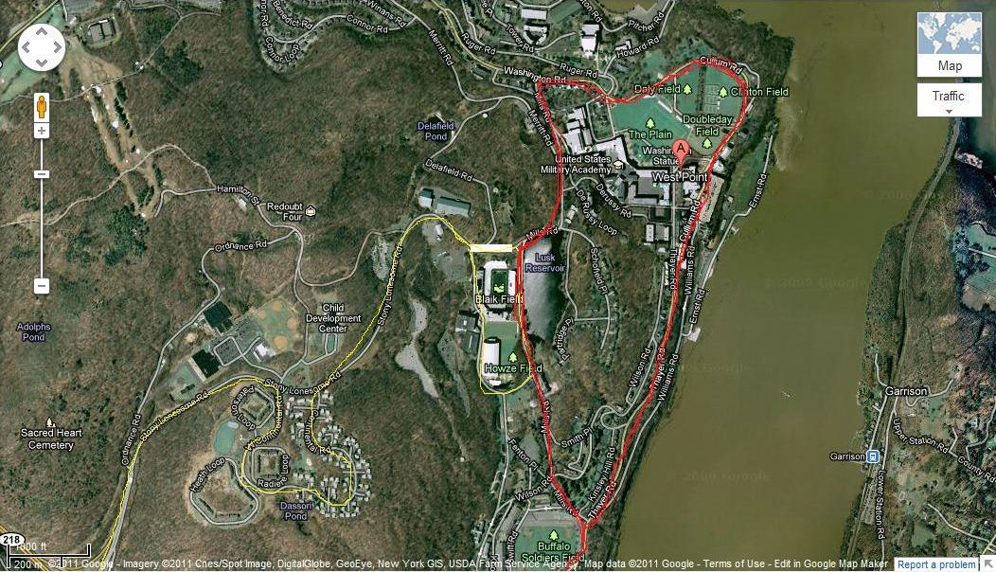
BLUF
The route with the highest
value and lowest cost is
route “Knockout” (identified by the orange circle on the graph.)
It has a cost of $104,936,682 and a value of 72.6.

Slide 5
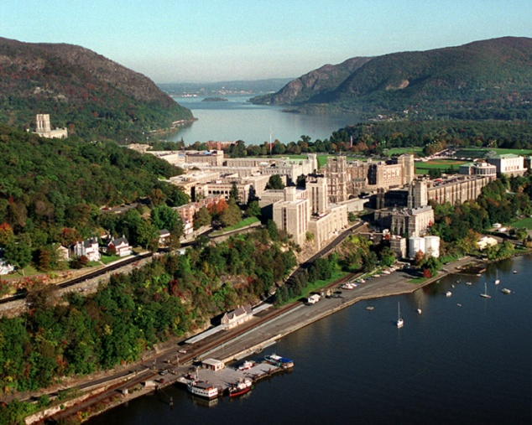
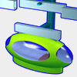
Engineering Problem
Statement
Problem: Currently their is a lack of efficient transportation around the academy. West Point currently faces the following problems when it comes to implementing an effective transportation system:
  Traffic
  Energy Waste
  Lack of Convenience
  Safety
Fundamental objective: Find the best way to implement the JPOD system in and around West Point.
The JPOD System must
  Provide Convenience
  Secure the Passengers
  Efficiently Transport Personnel
  Preserve the historic look of West Point
  Reduce West Points Carbon Footprint
Notes:
http://www.google.com/imgres?q=USMA&um=1&hl=en&sa=N&tbm=isch&tbnid=EqjtjkwQMyqBHM:&imgrefurl=http://en.wikipedia.org/wiki/File:USMA_Aerial_View_Looking_North.jpg&docid=KDx5a7kO0q479M&w=3000&h=2400&ei=A9ZuTsvrC8bogQfej8G3CQ&zoom=1&iact=hc&vpx=251&vpy=248&dur=194&hovh=201&hovw=251&tx=108&ty=103&page=1&tbnh=113&tbnw=141&start=0&ndsp=18&ved=1t:429,r:1,s:0&biw=1128&bih=610

Slide 6


Facts and Research
Why is this problem relevant?(Going Green)
  America is addicted to fuel
  Cars are an inefficient method of transportation.
What is the Net Zero Initiative?
  The Army way of Going Green
  West Point must be come a Net Zero Installation
How can West Point go Green?
  Implement a PRT System
What is a PRT System that West Point Can Use?
  JPOD
    Can Transport 4 Personnel
    Works on Solar Polar
    Can be adapted to an individual or group
Notes:
http://www.army.mil/symbols/
http://www.google.com/imgres?q=Go+Green&um=1&hl=en&biw=1280&bih=610&tbm=isch&tbnid=MRLwx6VgypavIM:&imgrefurl=http://affordableairductcleaners.com/Go-Green.html&docid=C3_RxzapBr3rrM&imgurl=http://affordableairductcleaners.com/images/go-green-recycle.gif&w=375&h=375&ei=a7bVToK5B8rAhAeJuvBo&zoom=1&iact=hc&vpx=896&vpy=159&dur=171&hovh=225&hovw=225&tx=114&ty=134&sig=112480937222856554988&page=1&tbnh=117&tbnw=117&start=0&ndsp=23&ved=1t:429,r:6,s:0

Slide 7
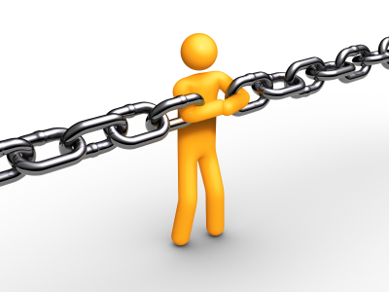
Assumptions, Constraints, and Limitations
Assumptions
  The system will function once implemented
  System will be self-sustaining
  People will use the JPOD System
  All Costs calculated in the Life Cycle Cost Model are accurate
  Our Queuing method accurately represents West Point.
Constraints
  Space available for track
  Building codes
  Funding
Limitations
  Confined to railing
  Limited space per pod
  Maximum speed limit
  Technology
Notes:
http://www.google.com/imgres?q=Constraints&um=1&hl=en&tbm=isch&tbnid=6LngcXAfmRzgyM:&imgrefurl=http://business901.com/blog1/using-the-theory-of-constrains-in-marketing/&docid=U2VtS3T5rKnnfM&w=400&h=300&ei=NSSJTo3JCcLx0gGB9lg&zoom=1&biw=1280&bih=640&iact=rc&dur=160&page=1&tbnh=126&tbnw=168&start=0&ndsp=21&ved=1t:429,r:12,s:0&tx=68&ty=61

Slide 8
System Environment- Spatial Arrangement
Met system
Transportation System
JPOD
Car
Train
System
Subsystem
Solar Panels
JPOD CAR
Rails

Slide 9
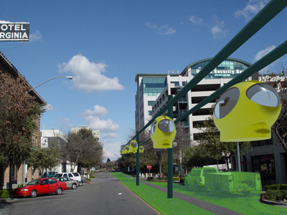
System Environment-System Boundary
Input:
Track, Pods, Stations
Output:
Transported Passengers, Cargo
Internal Feedback
System Computers, Fuel Consumed, Transportation Times
External Feedback: Cadets, Faculty, Residents

Slide 10
The Stakeholders- What is Wanted in the JPOD?
Stakeholder | Category | What They Want
COL Lachance | Decision Maker | Effective Transportation System at West Point
Bill James | Supplier | Sell the JPOD System
Faculty | User | Effective way to navigate on post
Families | User | Effective way to navigate on post
Cadets | User | Effective way to navigate on post
Hudson River Preservation Society | Consumer | Keep the natural feel of the Hudson
Garrison | Consumer | Preserve the Value of their Home
Highland Falls Resident | Consumer | Minimize Impact to their town
Visitor Center and Tourist | User | Transport Visitors
Balfour Beatty | User | Provide Convenience to homeowners

Slide 11
Stakeholder Analysis
Methods: Survey and Interview
Sample
Findings | Conclusion | Recommendations
Cares about the environmental preservation of West Point | Create a system that does not harm the environment history of West | In order to preserve the Environmental of the Hudson the JPOD system should be built away from the Hudson and key areas such as flirtation walk
The JPOD System must not interfere with the architecture of the area | There should be numerous stops for the JPOD | In order to pleasure user the JPOD should go all around post but have limited stops off posts.
JPOD system would stand out here at west point but wouldn’t be bad. Wouldn’t take away from historic features. Not necessary tearing down WP but would definitely help it in the end. | System would impact historic features but wouldn’t negatively impact them. | Produce age requirements and find best drop off locations.

Slide 12
Stakeholder Needs Related to System Environment
 | JPOD Problem Definition Matrix |  | Decision makers/Stakeholders Concerns
 |  |  | Decision Authority | Client | Owner | User | Consumer | Other (Research Organizations)
 | Environment Factors | Economic | Budget Analysis | Budget Analysis | System Upkeep |  | It needs to be cheap
 |  | Emotional |  |  | Vehicle Accidents | Noise
 |  | Historical |  | Match Look/Feel | Damaging to monuments | Damaging to monuments
 |  | Legal | State Building Laws | Building Codes | Building Codes
 |  | Natural Environment |  | May affect animal habitats |  | Impede Living Area
 |  | Organizational | Working w/ Public | Working w/ USMA
 |  | Security | Public Access into USMA |  | Passenger Security | Family Safety
 |  | Social | High Use |  | Public Use | Big Families | Friends
 |  | Technological | Power Concerns | Power Concerns | Power Concerns

Slide 13
Value Hierarchy
Implement JPODS
Transport Personnel
Maximize number of JPOD vehicles
Optimize speed
Reduce Emissions
Minimize energy wasted
Preserve West Point
Secure Passengers
Provide Convenience
Minimize historic buildings impacted
Maximize comfort
Maximize number of stops
Minimize human control
Minimize Wait
(MIB- Miles)
Wait Time
(LIB-minutes)
Number of stops
(MIB-stops)
Number Intersection
(LIB-Intersections)
Human procedures
(LIB- steps)
Number of JPODS (MIB-JPODS)
Number of buildings (LIB buildings)
Distance of Track
(MIB- miles)
Speed of JPOD (MIB- MPH)
Minimize Intersections
In order for the JPOD to be effective on west point it must meet these functions and Be Measured by these value Measures

Slide 14
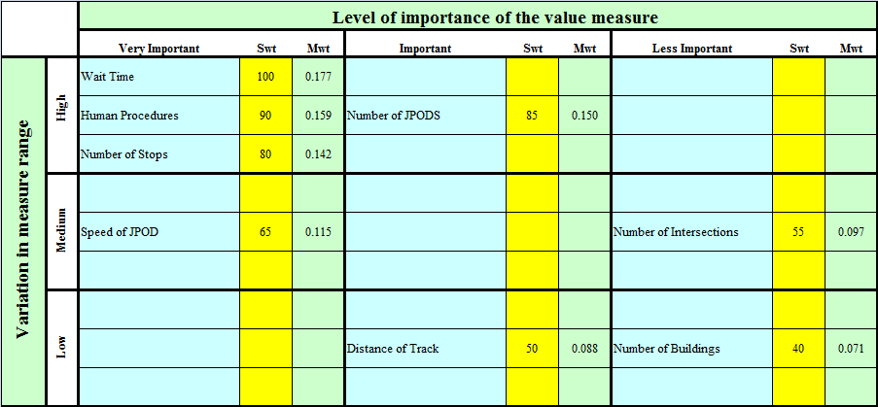
Swing Weight Matrix

Slide 15
Idea Generation
Methodology
  Based on Stakeholder Analysis
  Everyone Create Three Routes
Alternative Solutions | Distance of Track | Number of Stops
Garrison | 3 | 7
The Slug | 6 | 10
Cadet Activities | 9 | 10
Visitor Line | 9 | 8
The Athlete | 5 | 6
Olympian | 12 | 4
The Tourist | 13 | 7
Knockout | 4 | 10
Buckner | 15 | 8
The Gray Line | 9 | 9

Slide 16
Feasibility Screening Matrix
Alternative Solution | Number of Stops 7≤ x | Human Procedures x≤ 3 | Wait Time 10 ≥ x | Overall
Garrison | 7 No Go | 9 No Go | 15 No Go | No Go
The Slug | 10 Go | 6 No Go | 8 Go | No Go
Cadet Activities | 10 Go | 2 Go | 6 Go | Go
Visitor Line | 8 Go | 3 Go | 7 Go | Go
The Athlete | 6 No Go | 6 No Go | 4 Go | No Go
Olympian | 4 No Go | 4 No Go | 5 Go | No Go
The Tourist | 7 Go | 2 Go | 10 Go | Go
Knockout | 10 Go | 3 Go | 8 Go | Go
Buckner | 8 Go | 5 No Go | 2 Go | No Go
The Gray Line | 9 Go | 4 No Go | 4 Go | No Go

Slide 17
Routes

Slide 18
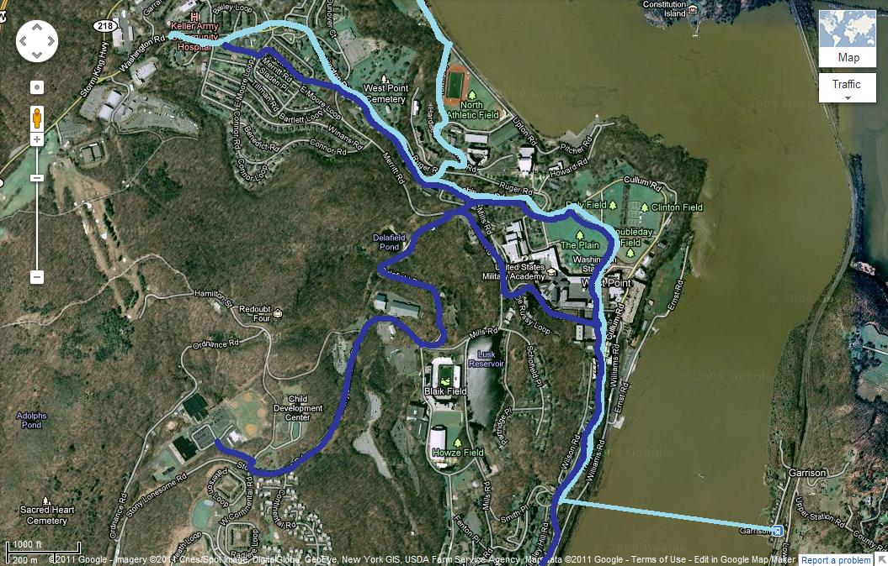
RTE: Cadet Activities(Sky Blue)

Slide 19
RTE: Visitor Line (Violet)

Slide 20
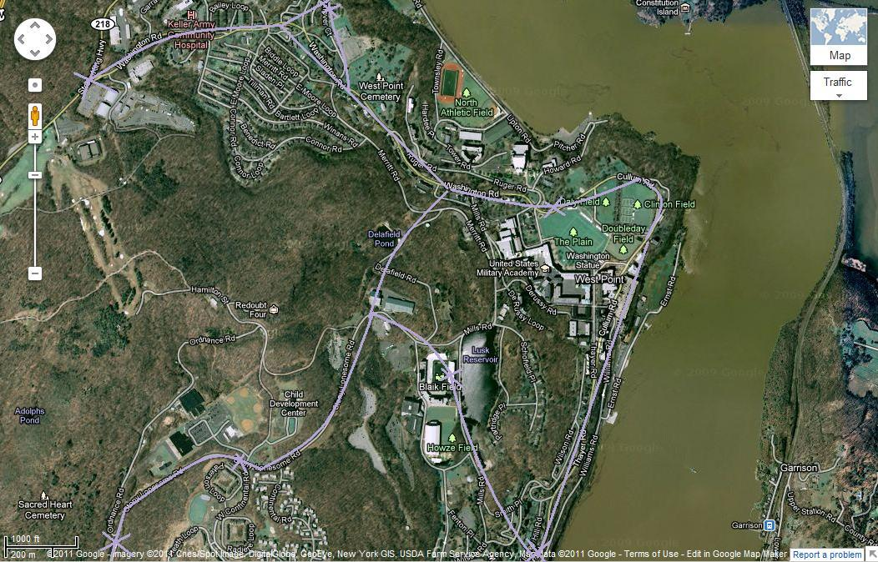
RTE: The Tourist

Slide 21
RTE Knockout (red)

Slide 22
Queuing
Assumption
Variables
Route | Mew | Service Rate | L | W
Garrison | 6 | 9 | 2 | 15
The Slug | 5 | 10 | 1 | 8
Cadet Activities | 5 | 10 | 1 | 6
Visitor Line | 5 | 10 | 1 | 7
The Athlete | 4 | 10 | 0 | 4
Olympian | 5 | 10 | 0 | 5
The Tourist | 6 | 9 | 1 | 10
Knock Out | 5 | 10 | 1 | 8
Buckner | 3 | 11 | 0 | 2
The Gray line | 4 | 10 | 0 | 4
L:Length of Queue
Lambda: Arrival Rate
Mew: Service Rate
W: Wait Time

Slide 23
Method-Raw Data Matrix
Raw Data Matrix: obtained from factual research & expert estimates
Measure ref:
Candidate Solution | Distance of Track | Number of Stops | Number of Intersections | Human Procedures | Number of JPODS | Speed of JPOD | Number of Buildings | Wait Time
Baseline | 3 | 5 | 7 | 8 | 2 | 25 | 5 | 30
The Tourist | 18 | 7 | 4 | 2 | 10 | 30 | 2 | 10
Cadet Actives | 12 | 10 | 4 | 2 | 10 | 30 | 2 | 6
Visitor Line | 12 | 8 | 3 | 3 | 12 | 30 | 4 | 7
Knockout | 6 | 10 | 4 | 3 | 14 | 35 | 2 | 8
Ideal | 18 | 10 | 1 | 1 | 16 | 45 | 0 | 5

Slide 24
Method-Value Functions
Number of Stops
x | Value
5 | 0
6 | 25
7 | 40
8 | 70
9 | 80
10 | 100
*Complete list of value functions and their graphs are listed on the backup slides

Slide 25
Method- Additive Value Model to Total Value
Route | Value
Baseline | 0.0
The Tourist | 64.2
Cadet Activities | 71.7
Visitor Line | 66.8
Knockout | 72.6
Ideal | 100.0
V(x)-Total Route Score
V(x)-Score of individual value measure based off of Raw Data
W-Normalized Swing Weight

Slide 26
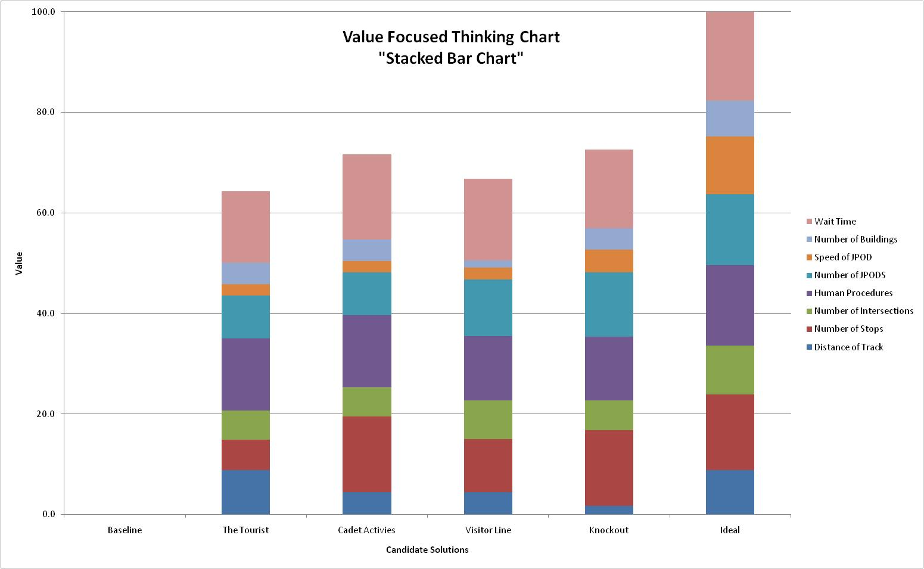
Total Value of the Routes

Slide 29
Stacked Bar Chart

Slide 30
Life Cycle Cost Model
Direct Construction Cost
First 20 Miles | $20 Million | Per Mile
Remainder | $10 Million | Per Mile
Acquisition Cost
Station | $ 40,000
Vehicles | $ 6,000
Personnel Requirements
Build a 10 Mile system | 300 | People
Maintaining | 15 | People
Special Weekends | 150 | People
Vehicles on System
First 2 Years | 3 Seconds between Vehicles
Follow on Year | 1/4 Second Between Vehicles
Occupation | Low | Most Likely | High
Welder | 11.51 | 17.04 | 25.82
Civil Engineer | 24.31 | 37.29 | 57.37
Mechanical Engineer | 24.30 | 37.58 | 57.44
Architect | 18.59 | 33.95 | 57.16
Surveyor | 11.28 | 18.22 | 29.27
General Construction | 18.08 | 21.24 | 23.56
Direct Operation Cost
Operating Cost | $0.04 | Per Vehicle Mile
Maintenance | $0.18 | Per Vehicle Mile

Slide 31
Life Cycle Cost
Route | Labor Cost | Acquisition Cost | Recurring Cost | Total Cost
Cadet Activities | 20,662,461.73 | 180152795.3 | 2900257.039 | 203,715,514.08
Visitor Line | 20,662,461.73 | 180183354.4 | 3480245.732 | 204,326,061.83
The Tourist | 20,662,461.73 | 260152795.3 | 2900195.443 | 283,715,452.48
Knockout | 20,662,461.73 | 80213913.43 | 4060306.622 | 104,936,681.78

Slide 32
Cost Vs Value
The route with the highest
value and lowest cost is
route “Knockout” (identified by the orange circle on the graph.)
It has a cost of $104,936,682 and a value of 72.6.

Slide 33
Questions?

Slide 34
References
Group Sources
  Bureau of Labor Statistics [internet]. United States Department of Labor. [cited 2011 NOV 11]] Available from http://bls.gov/
  Jacobs R, Chase R. 2011 Operations and Supply Chain Management. New York: Mcgraw-Hill Irwin. P248
  James B. 2011 NOV 1. JPODs [Internet].2011. Message to Aaron Mallory 1:31PM [cited 2011 NOV 13]
  Parnell, Gregory, Driscoll, Patrick and Henderson, Dale. Decision Making in System Engineering and Management. 2011, Hoboken New Jersey: John Wiley and Sons INC.

Slide 35
Sources
Going Green Sources
  Diamond, Jared. “What’s Your Consumption Factor?” New York Times 02 Jan 2011: 14 Sep. 2011 < http://www.nytimes.com/2008/01/02/opinion/02diamond.html>
  Harper, Scott. “The military’s new campaign: Cutting its energy costs.” Pilot Online 04 Sep. 2011: 14 Sep. 2011 < http://hamptonroads.com/2011/09/militarys-new-campaign-cutting-its-energy-costsl>
  McCain, John. “An Enduring Peace Built on Freedom: Securing America’s Future.” Foreign Affairs 86 (2007): 19-34
  Natural Resources Defense Council (NRDC). Safe Strong and Secure: Reducing America Oil Dependence 27 Oct. 2011. 14 Sep 2011. <http://www.nrdc.org/air/transportation/aoilpolicy2.asp>
  United States. Department of Defense (DOD). Army Identifies Net Zero Pilot Installations 20 Apr. 2011. 14 Sep 2011 <http://www.defense.gov/releases/release.aspx?releaseid=14420>
  United States. US Energy Information Administration. How dependent are we on foreign oil? Jun. 2011. 14 Sep 2011 <http://www.eia.gov/energy_in_brief/foreign_oil_dependence.cfm>
  United States. US Environmental Protection Agency. Environmental Tips 11 Jul. 2011. 14 Sep 2011 < http://www.epa.gov/earthday/tips.htm>
  United States. US Environmental Protection Agency. Our Mission 14 Sep. 2011. 14 Sep 2011 <http://www.epa.gov/aboutepa/index.html>
  Walsh, Bryan. “Top 20 Green Tech Ideas.” Time 06 Dec. 2011: 14 Sep. 2011 <http://www.time.com/time/specials/packages/article/0,28804,2030137_2030135_2021681,00.html>
  Walsh, Bryan. “The Surprisingly Long History of Green Energy.” Time 06 April 2011: 14 Sep. 2011 <http://www.time.com/time/printout/0,8816,2063521,00.html>
“Environmentalism.” Merriam Webster Dictionary. Online ed. 2011.

Slide 36
Sources
Net zero resources
  Ashmccall. "Army’s Net Zero Initiative." Army Live. Army Live, 10 Feb. 2011. Web. 6 Sept. 2011. <http://armylive.dodlive.mil/index.php/2011/02/armys-net-zero-initiative/>.
  Assistant of the Secretary. "Army Identifies Net Zero Pilot Installations." U.S Department of Defense. 20 Apr. 2011. Web. 6 Sept. 2011. <http://www.defense.gov/releases/release.aspx?releaseid=14420>.
  Booth, Samuel. "Net Zero Energy Military Installations: A Guide to Assessment and Planning." National Renewal of Energy Labatory. Aug. 2011. Web. 6 Sept. 2011. <http://www.nrel.gov/docs/fy10osti/48876.pdf>.
  Darden, Allan J. “Draft Finding Of No Significant Impact." Detrick. Web. 7 Sept. 2011. <http://www.detrick.army.mil/emo/NET_ZERO_ENERGY_INITIATIVE_PEA_26JUL2011.pdf>.
  Hemmerlybrown, Alexandra. "Army Launches 'Net Zero' Pilot Program | Article | The United States Army." The Official Home Page of the United States Army | The United States Army. 20 Apr. 2011. Web. 05 Sept. 2011. <http://www.army.mil/article/55280/army-launches-net-zero-pilot-program/>.

Slide 37
Sources
Personal Raid Transit Sources
  Anderson, J. Edward. An Intelligent Transportation Network System: Rationale, Attributes, Status, Economics, Benefits, and Courses of Study for Engineers and Planners. Minneapolis: PRT International, LLC, 2011.
  Centers for Disease Control. "CDC - Motor Vehicle Safety." Centers for Disease Control and Prevention. http://cdc.gov/motorvehiclesafety/index.html (accessed September 13, 2011)
  James, Bill. Interview by SE450 B Hour. Personal interview. Mahan Hall, September 7, 2011.
  Lowson, Martin V.. A New Approach To Sustainable Transport Systems. London: World Clean Air an
  McCall, Ash. "Armyâ€™s Net Zero Initiative." Army Live. http://armylive.dodlive.mil/index.php/2011/02/armys-net-zero-initiative/ (accessed September 13, 2011).
  Vuchic, Vukan R.. "Personal Rapid Transit: An Unrealistic System." Urban Transport International, Sep. - Oct. 1996.

Slide 38
Back Up Slides

Slide 39
Interim Progress Report
By
Cadet Andre Shinda
Cadet Aaron Mallory
Cadet Jason Jin
Cadet Samuel Edet

Slide 40
Worldwide concept of “Going Green”
Why America is taking a Green Stance
  Social Responsibility: Preserving the planet is everyone's job
  National Defense: We have a limited supply of oil
  Save Money: Oil is Expensive
How America is Going Green
  Finding Alternative forms of Energy (Solar, Ethanol Based, Wind)
How this fits into the Army Net Zero Initiative
  The Army’s Policy must be in sync with American Policies

Slide 41
Net Zero Initiative
Net Zero Initiative holistically involves the reduction, re-purpose, recycling and composting, energy recovery, and disposal of energy, water, and waste.
In reference to the JPOD system, the goal would be to take this holistic view of Net Zero Initiative and narrow it down to an efficient JPOD system that uses less energy in a practical sense while reusing what energy it does use.
The end state that is successfully done, the long term goal would be to revolutionize the transportation system around West Point and other Army instillations by means of the JPOD system and make other areas of interest interconnected to the JPOD system more proficient given its implementation.

Slide 42
Personnel Rapid Transit
Useful in densely populated areas
Would Reduce traffic congestion during rush hour
Would Reduce harmful atmosphere emissions
Not Enough Credible research on the system
  There are no reasonable examples currently out

Slide 43
JPOD System
What is it?
-A specific form of PRT, a JPOD is a small, efficient, safe, computer driven vehicle for transporting people and cargo.
How does it work?
-A JPOD runs suspended from an overhead rail (JPODs). This invention relates to a transportation system and more particularly to a system of highly distributed communications network of intelligent devices combined with ultra light vehicles suspended from rails and powered by electricity.
Why use it?
-This transportation system combination creates a convenient, energy efficient, safe, and environmentally friendly method of transportation. This system is compatible and easily integrated with existing systems.

Slide 44
Finding, Conclusion Recommendations
John Ansley (Contact Method Email-20 September 11)
Findings | Conclusion | Recommendations
Cares about the environmental preservation of West Point | Create a system that does not harm the environment history of West | In order to preserve the Environmental of the Hudson the JPOD system should be built away from the Hudson and key areas such as flirtation walk
Is a historian
Works out of Marist University

Slide 45
FCR Continued
Survey Results (Cadets and the West Point Community)
Findings | Conclusion | Recommendations
Cadets usually walk to the practice fields | Create a system that does not harm the environment history of West | The JPOD System should be able to accommodate groups people rarely travel alone at West Point
Cadets prefer not to use the bus system | There should be more Convenience than the bus system
If going some where cadets will travel in groups

Slide 46
FCR Continued
MP, Visitor Center
Findings | Conclusions | Recommendations
The JPOD System must not interfere with the architecture of the area | There should be numerous stops for the JPOD | In order to pleasure user the JPOD should go all around post but have limited stops off posts.
The JPOD System should be secure so that only authorized parties enter USMA.
The JPOD System must reach the outer limits of the campus at least, and the various nearby towns. | JPOD Must go all around post

Slide 47
FCR Continued
Belfour Beatty/ Highland Falls Resident
Findings | Conclusions | Recommendation
JPOD system sounds like an awesome idea. It is great for tourist and would help promote tourism in and around WP. | Implementing a JPOD system would positively impact the USMA and help to enhance its overall needs. | Consider someway to mask new technology so that it blends in with historic features.
JPOD system would stand out here at west point but wouldn’t be bad. Wouldn’t take away from historic features. Not necessary tearing down WP but would definitely help it in the end. | System would impact historic features but wouldn’t negatively impact them. | Produce age requirements and find best drop off locations.
It would be great to have another mode of transportation to for commuting purposes. Everyone would like this and it would save on gas. | Limitations such as child restrictions and areas that it can go into should be carefully assessed to produce the best possible results.
Child restriction would be a definite concern. Would want an age require so little kids are not riding on it..

Slide 48
Functional Hierarchy
Implement JPODS
Transport Personnel
(3.0)
Reduce Emissions
(5.0)
Preserve West Point
(4.0)
Secure Passengers
(2.0)
Provide Convenience
(1.0)

Slide 49
Function Flow Diagram
Transport Passengers
(1.0)
Reduce Emissions
(2.0)
Preserve West Point
(3.0)
Secure Passengers
(4.0)
Provide Convenience
(5.0)

Slide 50
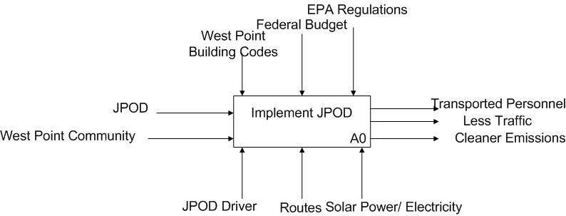
IDEF0
Rails/ Cars

Slide 51
IDEF0 Level 1 Model
Amount of people in each JPOD
Traffic rules
Restrictions
Destinations
Client Intent
People at their destinations
Used energy
People
Energy source
Means of operating on
Transport Personnel
Current Energy Standards
JPOD
Electricity
Reduce Emissions
Clean running system
Cleaner atmosphere
Energy Saving Applications
Opinions of stakeholders
Energy Saving Applications
Preserve West Point
Maintain aesthetics
JPOD system around West Point
Traffic rules
Guidelines for operations
Materials Used
Architecture
Secure Passengers
Consumer NWD
Personnel get to their desired locations as safe as possible.
No accidents
Provide Convenience
Transport people
Survey Results
Comfortable Passengers
Speed
Sensors
Computer
Seating
Handicap Ramps
Stops

Slide 52
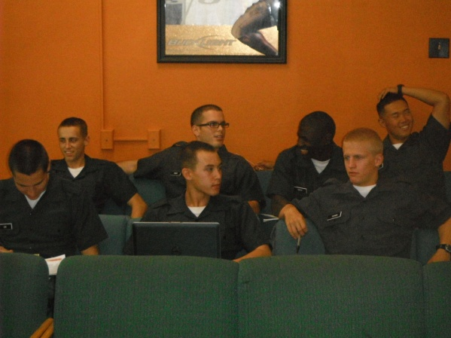
Cadet Survey Questions
Where do you find yourself walking towards the most?
What is your level of satisfaction with Transportation around USMA
Do you prefer a different mode of transportation other than the on post shuttle
How many stop would you like the on post shuttle to have?
How many occupants do you typically carry in your vehicle

Slide 53
Baseline Interview Question
How do you feel about the JPOD system now that you know the concept behind it?
Do you feel the JPOD system will have damaging effects on the overall aesthetics of West Point’s look and feel?
Do you find yourself arriving late to work due to traffic or bad road conditions? Explain.
With the rising prices of oil, would you prefer to use another mode of transportation?
Knowing what you know now about the JPOD system, what about it would you like it to do for you?
How would you benefit from use of the JPOD system?
How would you not benefit from use of the JPOD system?
Would you allow your child to use it if you had knowledge of who was in the JPOD with them and control the destination of it?
Where would you like a JPOD stop to be placed at if it were up to you?
What safety concerns do you have with the JPOD?

Slide 54
FCR Table
Findings | Conclusions | Recommendations
COL Lachance West Point is a net Zero Post. No money is currently allocated to JPODs No JPOD will exist until new barracks are built JPOD Manufactures JPODs are a very new system. JPOD are still not 100% self powered | COL Lachance System must power itself Cost Should not be considered as a factor now JPOD Manufacturer 1. JPODs need some development still in order to meet the army net zero initiative | COL Lachance Ensure that JPOD is incorporated with the new barracks and is able to power itself JPOD Manufacturer 1. Other Systems should be analyzed.

Slide 55
Design Workshop Brief 2
The Decision Makers
Aaron Mallory
Andre Shinda
Samuel Edet
Jason Jin

Slide 56
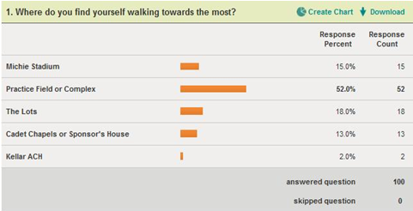
Survey Questions

Slide 57
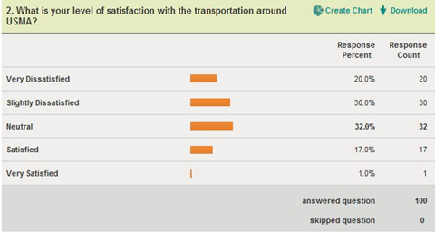
Survey Questions

Slide 58
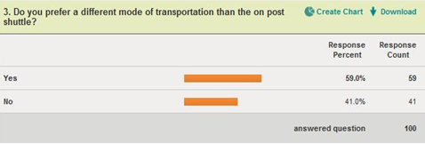
Survey Questions

Slide 59
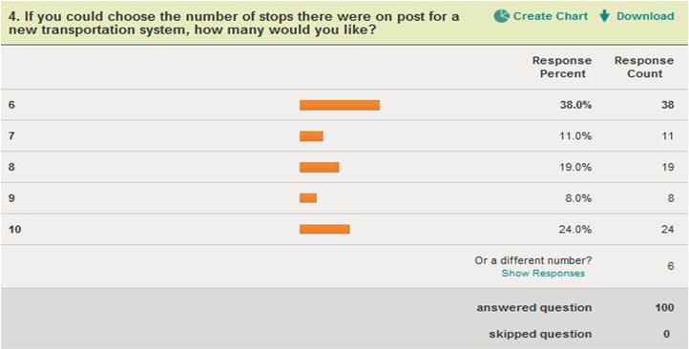
Survey Questions

Slide 60
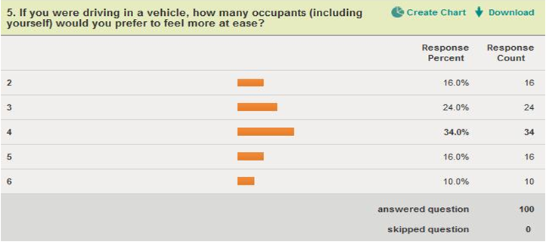
Survey Questions

Slide 61
Interim Progress Report 2
The Decision Makers
Aaron Mallory
Andre Shinda
Samuel Edet
Jason Jin

Slide 62

Team Member Roles and Responsibilities
Aaron Mallory- Group Leader
  Make sure content of the project is correct
Andre Shinda- Schedule Manager
  Scheduling group meetings
  Making Sure all deadlines are met
Samuel Edet- Information System Specialist
  Operating Survey Monkey
  Working In Excel
Jason Jin-Stakeholder Manager
  Contacting all Major Stakeholders after the initial interviews

Slide 63
IPR 1 BLUF
Implement JPODS
Transport Personnel
Maximize number of JPOD vehicles
Optimize speed
Reduce Emissions
Minimize energy wasted
Preserve West Point
Secure Passengers
Provide Convenience
Minimize historic buildings impacted
Maximize sensors
Maximize comfort
Maximize number of stops
Minimize human control
Number of seats (seats)
Wait Time
(minutes)
Number of stops (stops)
Number of sensors (sensors)
Human procedures
(steps)
Number of JPODS (JPODS)
Number of buildings (buildings)
Distance
( miles)
Speed of JPOD (MPH)
In order for the JPOD to be effective on west point it must meet these functions and Be Measured by these value Measures

Slide 64
Problem Definition
The problem that our team faces is the lack of efficient transportation around the academy. Because of this, the installation faces multiple problems:
Traffic
Energy Waste
Safety Problems
Multiple Other Issues.
Thus, our goal is to find the best way to implement the JPOD system in and around USMA.
Notes:
http://www.google.com/imgres?q=USMA&um=1&hl=en&sa=N&tbm=isch&tbnid=EqjtjkwQMyqBHM:&imgrefurl=http://en.wikipedia.org/wiki/File:USMA_Aerial_View_Looking_North.jpg&docid=KDx5a7kO0q479M&w=3000&h=2400&ei=A9ZuTsvrC8bogQfej8G3CQ&zoom=1&iact=hc&vpx=251&vpy=248&dur=194&hovh=201&hovw=251&tx=108&ty=103&page=1&tbnh=113&tbnw=141&start=0&ndsp=18&ved=1t:429,r:1,s:0&biw=1128&bih=610

Slide 65

Life Cycle Costing

Slide 66
Life Cycle Cost Model
Construction
First 20 Miles | $20 Million | Per Mile
Remainder | $10 Million | Per Mile
Acquisition Cost
Station | $ 40,000
Vehicles | $ 6,000
Operation Cost
Operating Cost | $0.04 | Per Vehicle Mile
Maintenance | $0.18 | Per Vehicle Mile
Vehicles on System
First 2 Years | 3 Seconds between Vehicles
Follow on Year | 1/4 Second Between Vehicles
Skilled Labor Required
Welding
Machining
Surveying
Civil Engineer
Mechanical Engineer
Electrical
Architects
Sensors
Personnel Requirements
Build a 10 Mile system | 300 | People
Maintaining | 15 | People
Special Weekends | 150 | People

Slide 67

Life Cycle Model
Types of Cost
  Acquisition
  Recurring and Nonrecurring Cost
  Direct and Indirect Cost

Slide 68
Acquisition Model
The ongoing cost to build JPODS network stations vehicles, power system, etc… is $20 Million per mile for the first vehicle mile plus 10 Million per mile after each additional mile
  Y=Total Cost
  X=Miles of Track laid

Slide 69
Acquisition Model
Purchasing a JPOD Car
  “Vehicles will range in cost from $6,000 to higher. In the Proforma they are estimated at $13,000.”
  Low: $6,000
  Expected: $13,000
  High: $21,000
Model: Triangular Distribution
  Assumption: The cost will not exceeded $21,000

Slide 70
Recurring Cost
Maintenance Cost
  Cost to pay for construction, operation, maintenance, and rebuilding is estimated at about 18 cents a vehicle-mile.
  Y=Cost
  X=Vehicle Miles traveled

Slide 71
Operating Cost
“Operating costs are about 4 cents per vehicle-mile.”
  Y=Cost
  X=vehicle mile

Slide 72

Direct Labor Cost
Assumption the skill set to oversee a JPOD is like that of a Subway operator
  “Things get interesting when we start looking at what train operators made. One took home over $81,000 on a base salary of $28.65 an hour.”
      X=total hours worked
      Y=total cost
Notes:
http://secondavenuesagas.com/2010/06/03/a-salary-too-high-or-simply-too-many-employees/

Slide 73
Working Cost
Cost of indirect labor related to the JPOD
Occupation | Low | Most Likely | High
Welder | 11.51 | 17.04 | 25.82
Civil Engineer | 24.31 | 37.29 | 57.37
Mechanical Engineer | 24.30 | 37.58 | 57.44
Architect | 18.59 | 33.95 | 57.16
Surveyor | 11.28 | 18.22 | 29.27
General Construction | 18.08 | 21.24 | 23.56
Notes:
All values taken from the Bearu labor and statistics http://www.bls.gov/oes/current/oes173031.htm

Slide 74
Life Cycle Cost
Route | Labor Cost | Acquisition Cost | Recurring Cost | Total Cost
Cadet Activities | 20,662,461.73 | 180152795.3 | 2900257.039 | 203,715,514.08
Visitor Line | 20,662,461.73 | 180183354.4 | 3480245.732 | 204,326,061.83
The Tourist | 20,662,461.73 | 260152795.3 | 2900195.443 | 283,715,452.48
Knockout | 20,662,461.73 | 80213913.43 | 4060306.622 | 104,936,681.78

Slide 75

Cost vs. Value

Slide 76
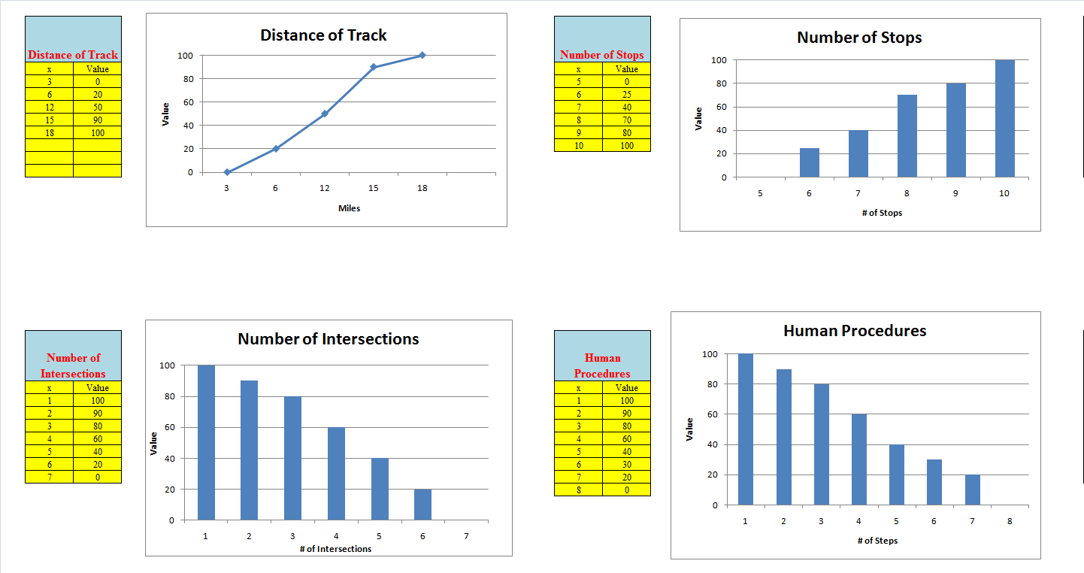
Value Functions

Slide 77
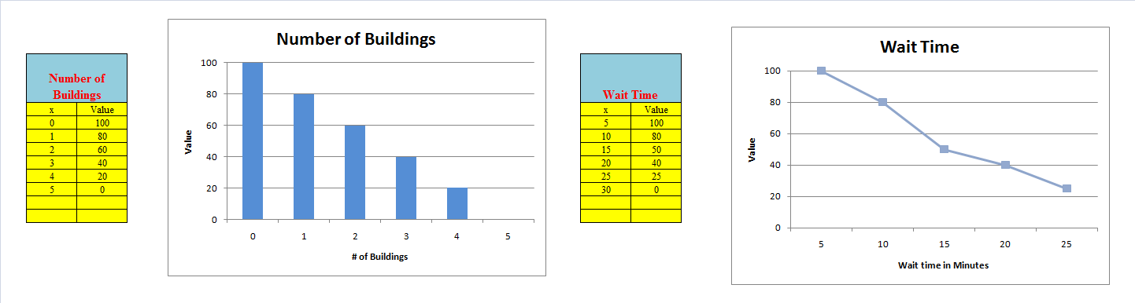
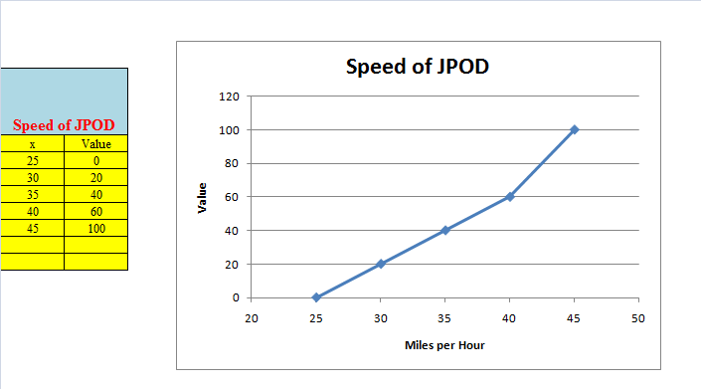
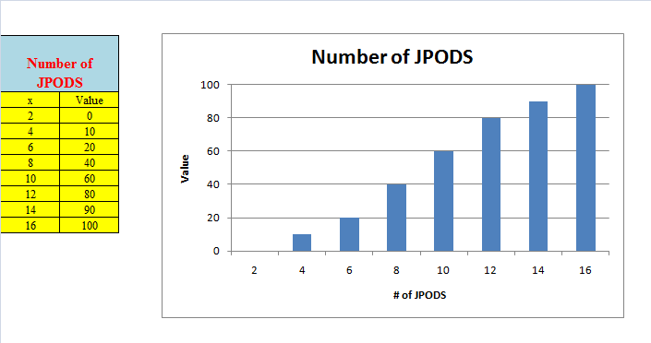
Value Functions

Slide 78
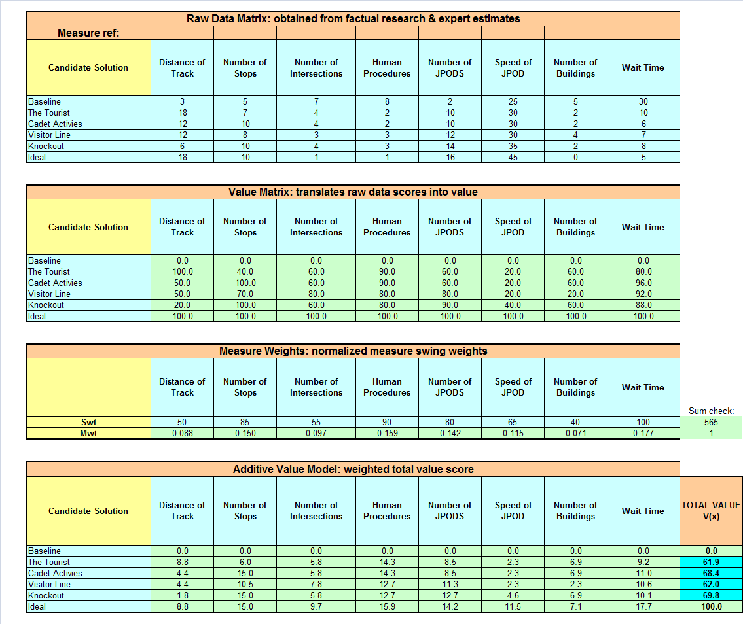
Stacked Bar Chart Data

