Slide 1
JPods Transportation System at West Point:
Final Decision Brief
Presented by The Dream Team
November 30, 2011

Slide 2




The Dream Team
CDT Hana Lee
  A-2, 2012
  International Relations major
  Project Manager
CDT Romedy Murr
  A-1, 2012
  International Relations major
  Technical Writer
CDT Ali Chouhdry
  B-1, 2012
  International Relations major
  Systems Modeling and Design
CDT Jeremy Provencher
  A-2, 2012
  Defense & Strategic Studies major
  Team Liaison Officer with Client and Stakeholders

Slide 3
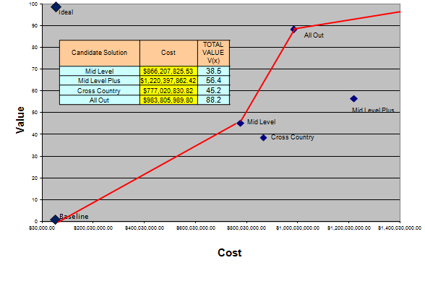
BLUF
Problem Statement: How can West Point implement the JPods transportation system in a way that is aesthetically pleasing, energy-efficient, passenger-friendly, and contributes to the NetZero Energy Initiative?
Solution Decision:
All Out

Slide 4
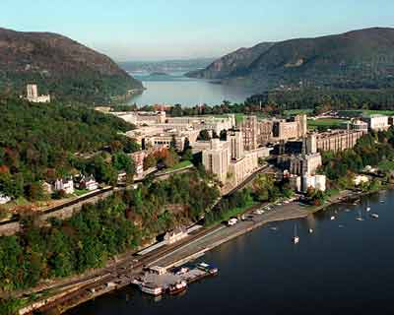
Agenda
Initial Problem Statement
Problem Definition
Value Hierarchy
Swing Weight Matrix
Alternatives
Raw Data Matrix
Screening Criteria
Feasibility Screening Matrix
Candidate Solutions
Additive Value Model
Candidate Solutions - $$$
Value Focused Thinking
Cost vs. Value
Sensitivity Analysis
Conclusion
Bibliography
Questions

Slide 5

Initial Problem Statement
What is the best way to implement the JPods system in and around West Point?

Slide 6
Problem Background
Client: COL Russell Lachance
Net Zero Strategy/Net Zero Installation Initiative
  Environmental stewardship, resource management, sustainability
  West Point as Net Zero – Energy pilot program
Transportation problems at West Point
  Accessibility: key areas on post are far away and hard to get to
  Too many cars: traffic, congestion, waste of space, pollution
  Bus system: slow and inefficient
JPods system is an environmentally-friendly way to address transportation problems at West Point

Slide 7
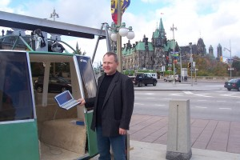
Systems Thinking Concepts
Classification: physical, non-living, man-made
Visibility: grey box (for most people)

Slide 8
Spatial Arrangement
WEST POINT
TRANSPORTATION NETWORK
Metasystem
BUS SYSTEM
JPods
SYSTEM
POVs
Systems
STATIONS AND ROUTES
Subsystems
Lateral Systems – Same Hierarchy/Different Function
Multilateral Systems – Same Hierarchy/Same Function

Slide 9
System Boundary
JPods System
Inputs From Environment: Time, Planning, Labor, Usage, Budget, Solar Energy
Outputs Into Environment: JPods System
JPods cars
Stations
Rails
Computer System
Routes
People
Internal Feedback
External Feedback
Internal Feedback: Corps of Cadets, USMA faculty and staff, West Point Garrison Community
External Feedback: visitors, Association of Graduates, Army/Department of Defense, environmental groups

Slide 10
Literature Review Summary
Net Zero Energy Installation (NZEI)
  1) implement conservation and energy-efficiency measures while identifying other areas for cutting back on energy consumption
  2) utilize or re-purpose waste energy (ex. exhaust)
  3) implement clean energy sources (ex. solar power) that lessen the installation’s overall environmental footprint
Environmental Benefits of JPODS System
  Solar power = less fuel consumption, less pollution
  183 miles per gallon in city traffic (one stop principle)
  Utilizes less land to operate, saving space for trees and vegetation

Slide 11
Literature Review Summary (cont.)
Economic Benefits of JPODS System
  Average working families could save $2000 over 3-6 years in transportation costs (fuel, maintenance, insurance, etc.)
  Implementation of system creates jobs for an environmentally-friendly and cost-saving project
  Less dependence on oil
Technical Characteristics of JPODS System
  Suspending vehicles increases stability so that weight of car can be reduced by half
  Hanging by beam allows pods to be powered by solar panels overhead
  Pods travel at 100-200 watt-hours per mile
  Solar panels gather 12,000 vehicle-miles of power per day per mile of rail

Slide 12
Literature Review Summary (cont.)
Personal Rapid Transit (PRT) Systems
  Capacity of 1-6 passengers, operate on the schedule of passenger
  Morgantown PRT (West Virginia University)
    Operating since 1975
    Most riders in a day = 31,280
  ULTra (Heathrow Airport in London, England)
  2getthere (Abu Dhabi, United Arab Emirates)

Slide 13
Stakeholder Analysis
List of Stakeholders
COL Russell Lachance
Mr. Michael Tesik, State Historical Preservation Office (SHPO)
Village of Cold Springs
Mr. Rasmussen, Chief of Transportation and Maintenance Division for West Point
Corps of Cadets
West Point staff and faculty
West Point Garrison Community

Slide 14
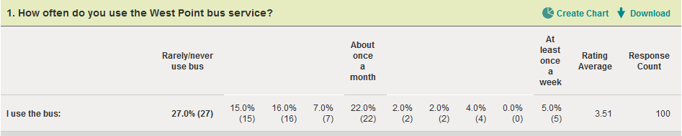
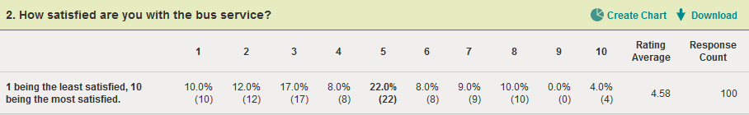
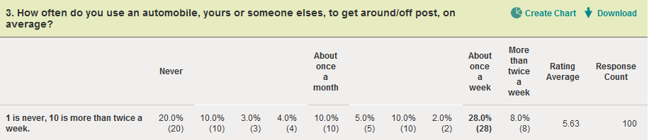
Stakeholder Analysis (cont.)

Slide 15
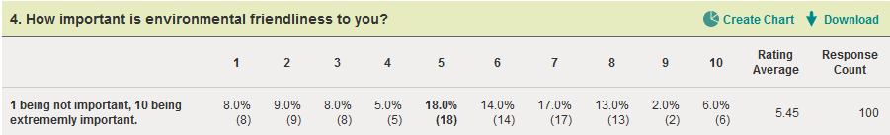
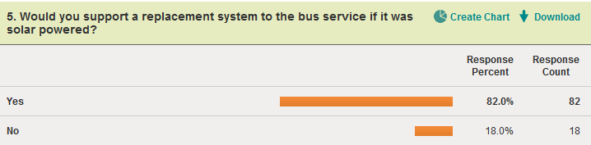
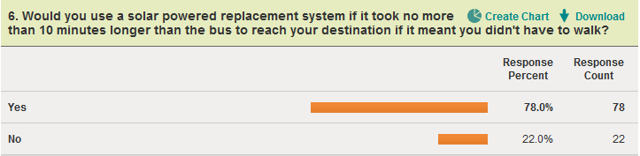
Stakeholder Analysis (cont.)

Slide 16
Stakeholder Analysis (cont.)
Some responses from the Corps of Cadets:
“Fine as long as there was efficient transportation.”
“Fine if public transportation were just as fast, otherwise angry.”
“Annoyed.”
“If it was fast and easy than it would be fine, but it would have to be fast.”
“Not thrilled.”
“This seems a little bit extreme, Firsties and cows have POVs, this would just inconvenience them.”
“I would disagree with it because I don't think West Point has the capacity to create a reliable timely system.”

Slide 17
Stakeholder Analysis (cont.)
Findings | Conclusions | Recommendations
Aesthetics: Traditional “look and feel” of West Point must be maintained. Environment: West Point is home to many significant species of wildlife and vegetation. | Transportation system must appeal to users. | Route for transportation system will stop at the same key areas that the bus system currently visits.
 | People factor in environmental-friendliness into their transportation options.
Approximately 125 people use bus system per month.
 | New transportation system must be at least as effective as bus system. | Route for transportation system will travel along roads and walkways already established to avoid harming wildlife and vegetation.
Approximately 1/3 of all workers park in central parking areas.
95% of people can find parking. | New transportation system must aesthetically compliment the traditional West Point “look and feel.”
 |  | JPods system will replace bus system.
Cadet satisfaction with bus service is 4.58 (on scale of 1-10).
 | New system must not disrupt native wildlife and vegetation in the Hudson River area.
87% of cadets use bus system less than once a month.

Slide 18
Problem Definition Matrix
JPODS System Risk Matrix |  | Decision Makers and Stakeholder Concerns
 |  | Corps of Cadets | Staff, Faculty, West Point Garrison Community | Transportation and Maintenance Division | Village of Cold Springs | State Historical Preservation Office
Environmental Factors | Cultural | Frustration with current transportation | Dependence on POVs
 | Economic |  | Budget concerns | Budget concerns | Real estate value
 | Emotional | Attachment to current system | Attachment to current system |  | Aesthetic concerns
 | Historical | West Point traditions | West Point traditions |  | Historical aesthetics | Historical aesthetics
 | Legal |  | Building codes | Building codes
 | Moral/Ethical
 | Natural Environment | Look and feel of West Point | Look and feel of West Point | Look and feel of West Point | Preserving landscape | Preserving landscape
 | Organizational | Changing SOP for usage | Changing SOP for usage | Incorporating JPODS into existing systems
 | Political |  | Civil-Military Relations | Department within USMA bureaucracy | Civil-Military Relations
 | Security
 | Social | Cadet culture | “Corps has” mentality
 | Technological |  | User-friendly for people of all ages | Building new technology

Slide 19


Redefined Problem Statement
How can West Point implement the JPods transportation system in a way that is aesthetically pleasing, energy-efficient, passenger-friendly, and contributes to the NetZero Energy Initiative?
+
=

Slide 20
Assumptions, Constraints, Limitations
Assumptions | Constraints | Limitations
Life cycle = 30 years | NetZero Initiative | Available land
Each JPods car holds 4 people | Community opinion
Unlimited cars | Building codes
Cars are not included in the life cycle cost model | Existing infrastructure
System runs for 12 hours per day, every day, non-stop (Hermes PRT program runs non-stop) | Passenger capacity

Slide 21
Functional Hierarchy
Implement JPods System at West Point
(1) Transport People
(2) Enhance Transportation Experience
(3) Conserve Energy
1.1 – Measure length of track in each route
1.2 – Analyze usage of system compared to older methods
2.1 – Develop schedule for Pods
2.2 – Assess improvement to current system
3.1 – Research NetZero Initiative
3.2 – Assess energy usage

Slide 22
IDEF0 – Level 0
CONTROLS:
Building codes
Community opinion
Existing Infrastructure
NetZero Initiative
Passenger Capacity
INPUTS:
Funding
Passengers
Solar energy
OUTPUTS:
Faster travel times
Efficient transportation
Satisfied users
Minimal environmental effects
Implement JPods
MECHANISMS:
JPods cars
Rails
Routes
Stations
Computer System
People

Slide 23
IDEF0 – Level 1
Passenger Capacity
Transport People
Passengers
Satisfied Users
JPods
Rails
Routes
Stations
Computer System
Users
Community Opinion
Passenger Capacity
Enhance Transportation Experience
Funding
Power
Passengers
Faster Travel Times
Efficient Transportation
Satisfied Users
NET Zero Initiative
Pods
Routes
Stations
Parking Lots
Users
Conserve Energy
Minimal Environmental Effect
Efficient Transportation
Routes
Stations
Computer System
Users
Funding
Power

Slide 24
Value Hierarchy
Implement JPods System at West Point
Fundamental Objective
1.0 Transport People
2.0 Enhance Transportation Experience
3.0 Conserve Energy
Functions
1.1 Maximize Area Coverage
1.2 Maximize Number of Stops
2.1 Minimize Wait Time
3.1 Maximize People Using JPods
Objectives
1.1.1. Amount of track (miles) (MIB)
1.2.3. Stops in Residential Areas (#) (MIB)
3.1.1. People On System In A Day (#) (MIB)
1.2.2. Stops in Visitor Areas (#) (MIB)
2.1.1 Average Wait Time At All Stations (sec.) (LIB)
Value Measures
1.2.1. Stops in Cadet Area (#) (MIB)

Slide 25
Swing Weight Matrix
 |  | Level of importance of the value measure
 |  | Very Important | Swt | Mwt | Important | Swt | Mwt | Less Important | Swt | Mwt
Variation in measure range | High
 |  | People On System In A Day | 100 | 0.260 | Stops in Residential Areas | 65 | 0.169
 | Medium
 |  | Amount of Track | 90 | 0.234 | Stops in Cadet Area | 60 | 0.156 | Average Wait Time At All Stations | 20 | 0.052
 | Low
 |  |  |  |  | Stops in Visitor Areas | 50 | 0.130
 |  | Swing Weight Sum: | 385
 |  | Normalized Measure Weight Sum Check: | 1.000

Slide 26
Alternative Ideation Process
Used map of West Point
Plotted key locations (identified by stakeholder analysis) on map for stations
Used the best ways to travel between key locations for rail routes
Zwicky’s Morphological Box
Design Decisions
Amount of Track (miles) | Stops in Cadet Area (#) | Stops in Visitor Areas (#) | Stops in Residential Areas (#)
1 | 1 | 1 | 1
2 | 2 | 2 | 2
3 | 3 | 3 | 3
4 | 4 | 4 | 4
5 | 5 | 5 | 5
6 | 6 | 6 | 6
7 | 7 | 7 | 7
8 | 8 | 8 | 8
9 | 9 | 9 | 9
10 | 10 | 10 | 10

Slide 27
Alternatives
Bare Minimum
Bare Minimum Plus
Mid Level
Mid Level Plus
Cross Country
All Out

Slide 28
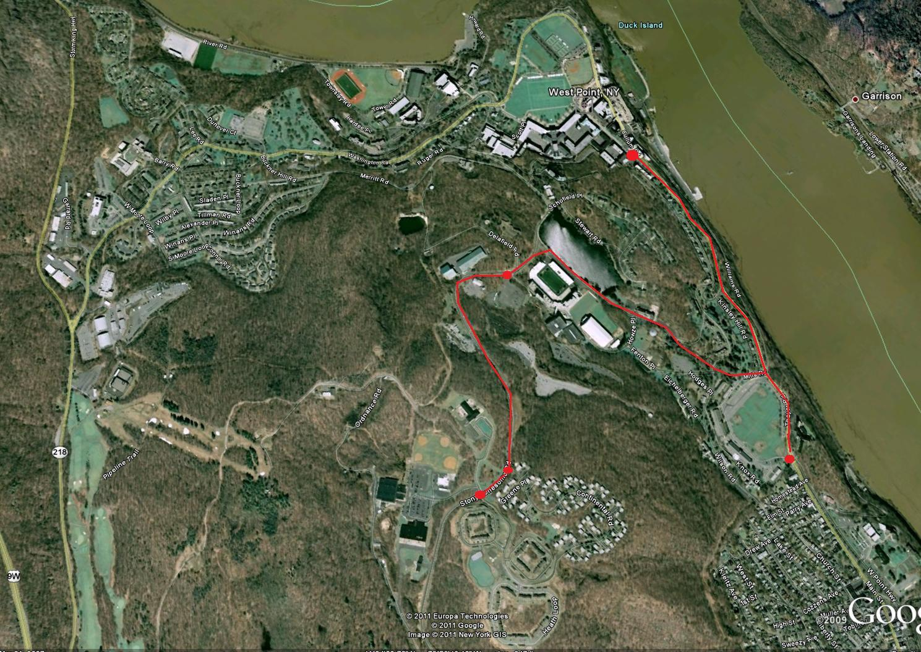
Bare Minimum

Slide 29
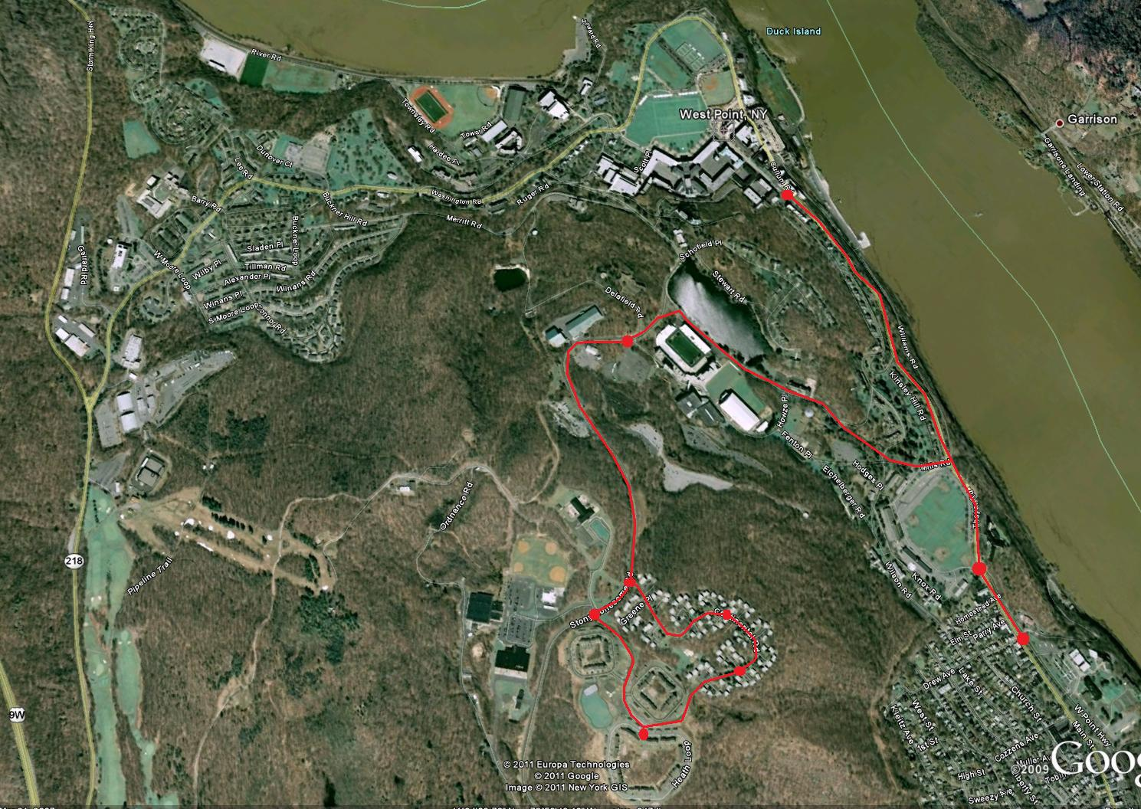
Bare Minimum Plus

Slide 30
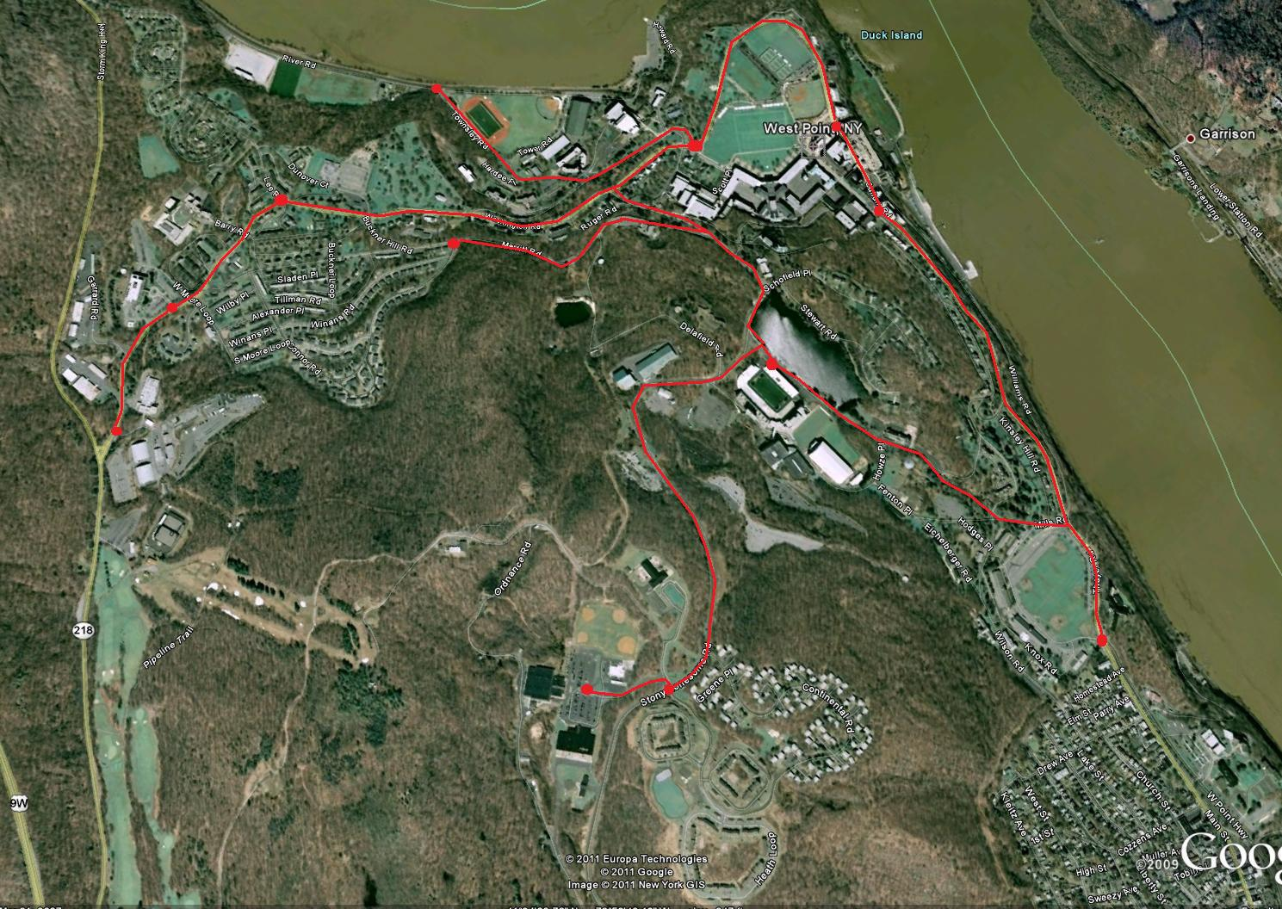
Alternative - Mid Level

Slide 31
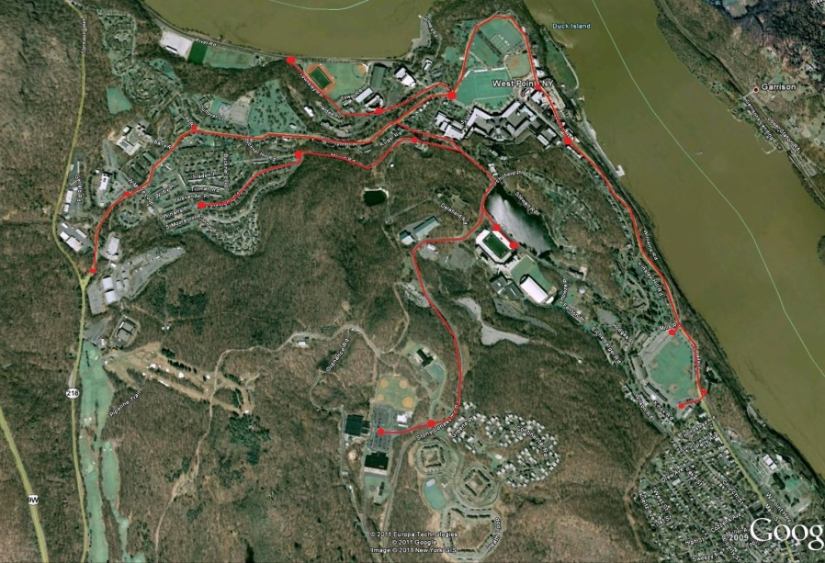
Alternative - Mid Level Plus

Slide 32

Alternative - Cross Country

Slide 33
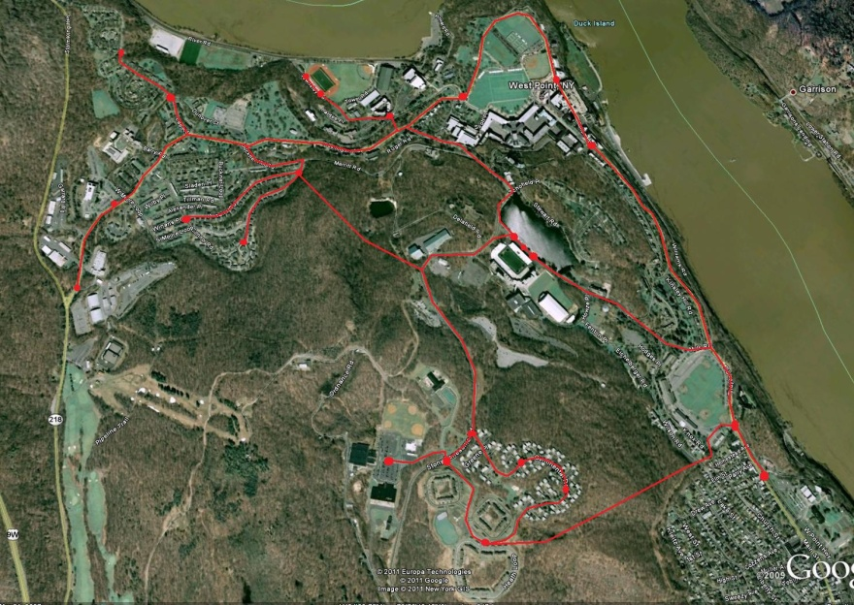
Alternative – All Out

Slide 34
Raw Data Matrix
 | Amount of Track (miles) | Stops in Cadet Area (#) | Stops in Visitor Areas (#) | Stops in Residential Areas (#) | Average Wait Time At All Stations (sec.) | People On System In A Day (#)
Bare Minimum | 2.54 | 3 | 0 | 2 | 30 | 7592
Bare Minimum Plus | 3.48 | 2 | 2 | 5 | 22 | 10368
Mid Level | 6.43 | 5 | 4 | 3 | 23 | 17200
Mid Level Plus | 6.19 | 8 | 6 | 4 | 26 | 22940
Cross Country | 6.44 | 5 | 5 | 4 | 23 | 19324
All Out | 8.88 | 7 | 7 | 10 | 21 | 30000

Slide 35
Screening Criteria
Route must have at least 3 miles of track
Route must have at least 1 stop in Cadet Area, 1 stop for visitors, and 1 stop in residential area
Route must allow for at least 15,000 people on the system in 1 day

Slide 36
Feasibility Screening Matrix
 | Amount of Track (≥3 miles) | Stops in Cadet Area (≥1 stop) | Stops in Visitor Areas (≥1 stop) | Stops in Residential Area (≥1 stop) | People On System In A Day (≥15,000 people) | Valid Solution
Bare Minimum | 2.54 NO GO | 3 GO | 0 NO GO | 2 GO | 7,592 NO GO | NO GO
Bare Minimum Plus | 3.48 GO | 2 GO | 2 GO | 5 GO | 10,368 NO GO | NO GO
Mid Level | 6.43 GO | 5 GO | 4 GO | 3 GO | 17,200 GO | GO
Mid Level Plus | 6.19 GO | 8 GO | 6 GO | 4 GO | 22,940 GO | GO
Cross Country | 6.44 GO | 5 GO | 5 GO | 4 GO | 19,324 GO | GO
All Out | 8.88 GO | 7 GO | 7 GO | 10 GO | 30,000 GO | GO

Slide 37
Candidate Solutions
Mid Level
Mid Level Plus
Cross Country
All Out

Slide 38
Example: Value Functions – Amount of Track
Measure: Transport People – Maximize Area Coverage
Range: 3 miles – 5 miles
Amount of Track
x | Value
3 | 0
5 | 30
7 | 60
9 | 90
10 | 100

Slide 39
Additive Value Model
Values attained from inputting raw data into Value Functions,
Candidate Solutions | Amount of Track (miles) | Stops in Cadet Area (#) | Stops in Visitor Areas (#) | Stops in Residential Areas (#) | Average Wait Time At All Stations (sec.) | People On System In A Day (#)
Mid Level | 51.5 | 50.0 | 40.0 | 30.0 | 89.0 | 14.7
Mid Level Plus | 47.9 | 80.0 | 60.0 | 40.0 | 86.0 | 52.9
Cross Country | 51.6 | 50.0 | 50.0 | 40.0 | 89.0 | 28.8
All Out | 88.2 | 70.0 | 70.0 | 100.0 | 91.0 | 100.0

Slide 40

Additive Value Model (cont.)
Candidate Solutions | Amount of Track (miles) | Stops in Cadet Area (#) | Stops in Visitor Areas (#) | Stops in Residential Areas (#) | Average Wait Time At All Stations (sec.) | People On System In A Day (#) | TOTAL VALUE V(x)
Mid Level | 12.0 | 7.8 | 5.2 | 5.1 | 4.6 | 3.8 | 38.5
Mid Level Plus | 11.2 | 12.5 | 7.8 | 6.8 | 4.5 | 13.7 | 56.4
Cross Country | 12.1 | 7.8 | 6.5 | 6.8 | 4.6 | 7.5 | 45.2
All Out | 20.6 | 10.9 | 9.1 | 16.9 | 4.7 | 26.0 | 88.2
= Normalized Swing Weights
= Raw Data (score of Value Measure)
= Value attained from Value Function
= Total Score for Candidate Solution

Slide 41
Value-Focused Thinking

Slide 42
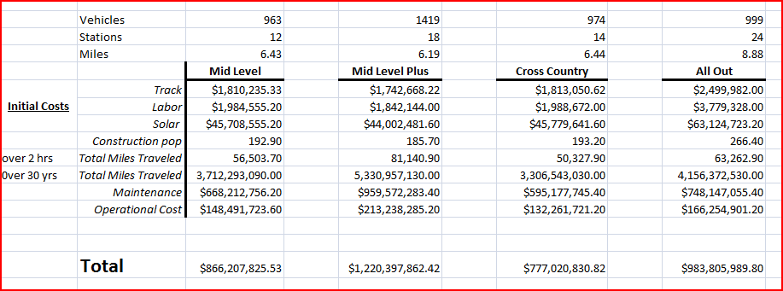
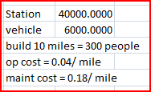
Life Cycle Cost

Slide 43
Types of Costs
Acquisition Cost | Fixed Costs | Variable Costs | Recurring Costs | Nonrecurring Costs | Direct Costs | Indirect Costs
Station Vehicle Track Labor Solar | Station Vehicle | Operational Maintenance Track Labor Solar | Operational Maintenance Solar Vehicle Track Labor | Station | Labor Material Expenses (contracted work) | Janitorial services Training

Slide 44
Cost vs. Value

Slide 45
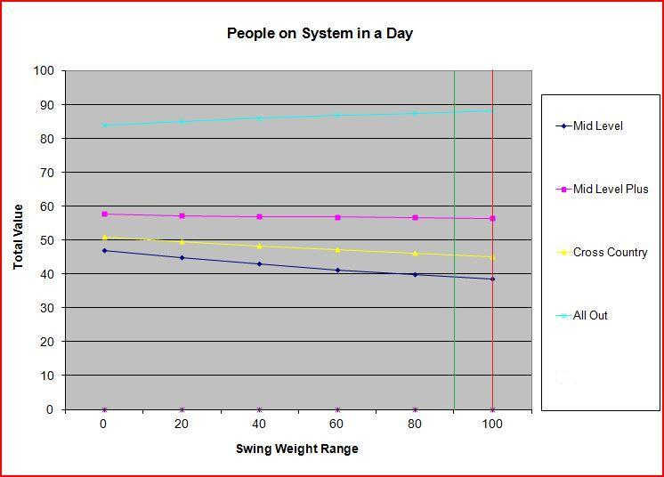
Sensitivity Analysis - People On System In A Day
Not sensitive, not significant, most important value measure, large range

Slide 46
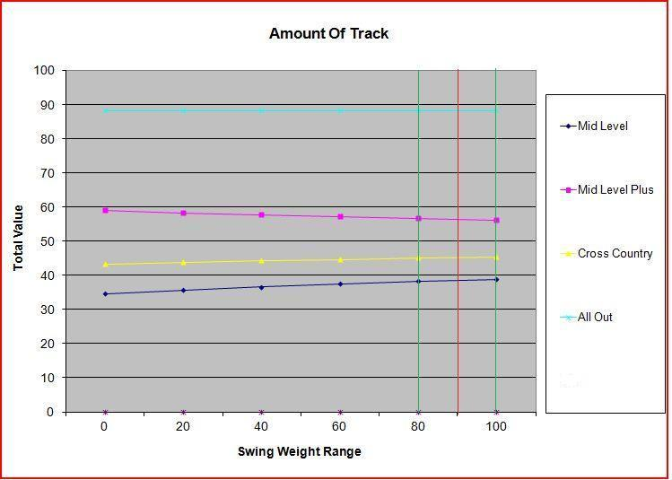
Sensitivity Analysis – Amount of Track
Not sensitive, not significant, 2nd most important value measure, medium range

Slide 47
Conclusion
Problem Statement: How can West Point implement the JPods transportation system in a way that is aesthetically pleasing, energy-efficient, passenger-friendly, and contributes to the NetZero Energy Initiative?
Solution Decision:
All Out

Slide 48
Works Cited
Goldsmith, Wendi and Barnhart, Barton. “Implementing a DoD Net-Zero Strategy.” The Military Engineer (2011): 73-74.
Gibson, Tom. “Still in a Class of Its Own.” Progressive Engineer (2002). 13 Sep. 2011
Hemmerlybrown, Alexandra. “Army launches ‘Net Zero’ pilot program.” The United States Army: News Archive 20 Apr. 2011. 14 Sep. 2011
James, Bill. “Personal Rapid Transit: Preempting the Need for Oil in Urban Transport.” SeekingAlpha 2 Jul. 2008. 14 Sep. 2011
James, Bill. JPods. FAQs page. JPods, Corp. 14 Sep. 2011
Jeffrey, Cathleen. “China trade delegation discusses JPods in Boston; Demonstration Planned for Hull.” The Hull Sun Web Blog. 26 Jul. 2011. 14 Sep. 2011
JPODs: It Costs Less to Move Less. 13 September 2011.
National Renewable Energy Laboratory. United States Department of Energy. Net Zero Energy Military Installations: A Guide to Assessment and Planning Aug. 2010.
Parnell, G.S., Driscoll, P.J., and Henderson D.L., Editors, Decision Making for Systems Engineering and Management, 2nd Edition, Wiley & Sons Inc., 2008. Pages 11-12.
South Shore Mobility, Inc. 2011. 13 September 2011.
United States. Dept. of Defense. Dept. of Army. 2011 Army Posture Statement: Army Net Zero Installation Initiative. Jul. 2011. 14 Sep. 2011
United States. Dept. of Defense. Dept. of Army. Office of the Assistance Secretary of the Army. Army Vision For Net Zero: Net Zero Is A Force Multiplier (White Paper). Dec. 2010. 14 Sep. 2011

Slide 49

Questions?

Slide 50
Value Functions – Amount of Track
Measure: Transport People – Maximize Area Coverage
Range: 3 miles – 5 miles
Amount of Track
x | Value
3 | 0
5 | 30
7 | 60
9 | 90
10 | 100

Slide 51
Value Functions – Stops in Cadet Area
Measure: Transport People – Maximize Number of Stops
Range: 1 stop – 10 stops
Stops in Cadet Area
x | Value
1 | 0
2 | 20
3 | 30
4 | 40
5 | 50
6 | 60
7 | 70
8 | 80
9 | 90
10 | 100

Slide 52
Value Functions – Stops in Visitor Area
Measure: Transport People – Maximize Number of Stops
Range: 1 stop – 10 stops
Stops in Visitor Areas
x | Value
1 | 0
2 | 20
3 | 30
4 | 40
5 | 50
6 | 60
7 | 70
8 | 80
9 | 90
10 | 100

Slide 53
Value Functions – Stops in Residential Areas
Measure: Transport People – Maximize Number of Stops
Range: 1 stop – 10 stops
Stops in Residential Areas
x | Value
1 | 0
2 | 20
3 | 30
4 | 40
5 | 50
6 | 60
7 | 70
8 | 80
9 | 90
10 | 100

Slide 54
Value Functions – Average Wait Time At All Stations
Measure: Enhance Transportation Experience – Minimize Wait Time At All Stations
Range: 10 seconds – 120 seconds
Average Wait Time At All Stations
x | Value
10 | 100
30 | 75
60 | 50
80 | 25
120 | 0

Slide 55
Value Functions – People On System In A Day
Measure: Conserve Energy – Maximize People Using JPods
Range: 15,000 people – 30,000 people
People On System In A Day
x | Value
15000 | 0
18000 | 20
21000 | 40
24000 | 60
27000 | 80
30000 | 100

